Slide 1


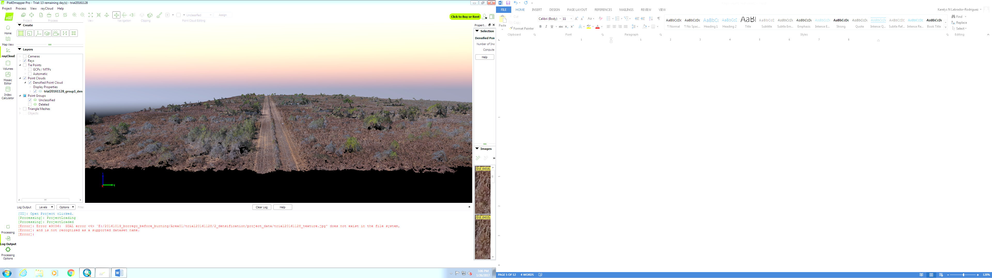
The Landscape Ecology and Drone (LEAD) Program in Rangeland, Wildlife and Fisheries Management
Humberto L. Perotto-Baldivieso
Associate Professor in Landscape Ecology
Department of Rangeland, Wildlife, and Fisheries Management
Texas A&M University
Email: Humberto.Perotto@agtamu.edu

Slide 2
Landscape Ecology and drones
Not all classrooms have four walls (RWFM)
APPLIED
RESEARCH
CLASSROOM
LEARNING
LEAD
PROGRAM
HANDS-ON
EXPERIENCE

Slide 3
Landscape Ecology: Pattern and Process
(Perotto-Baldivieso 2021)

Slide 4
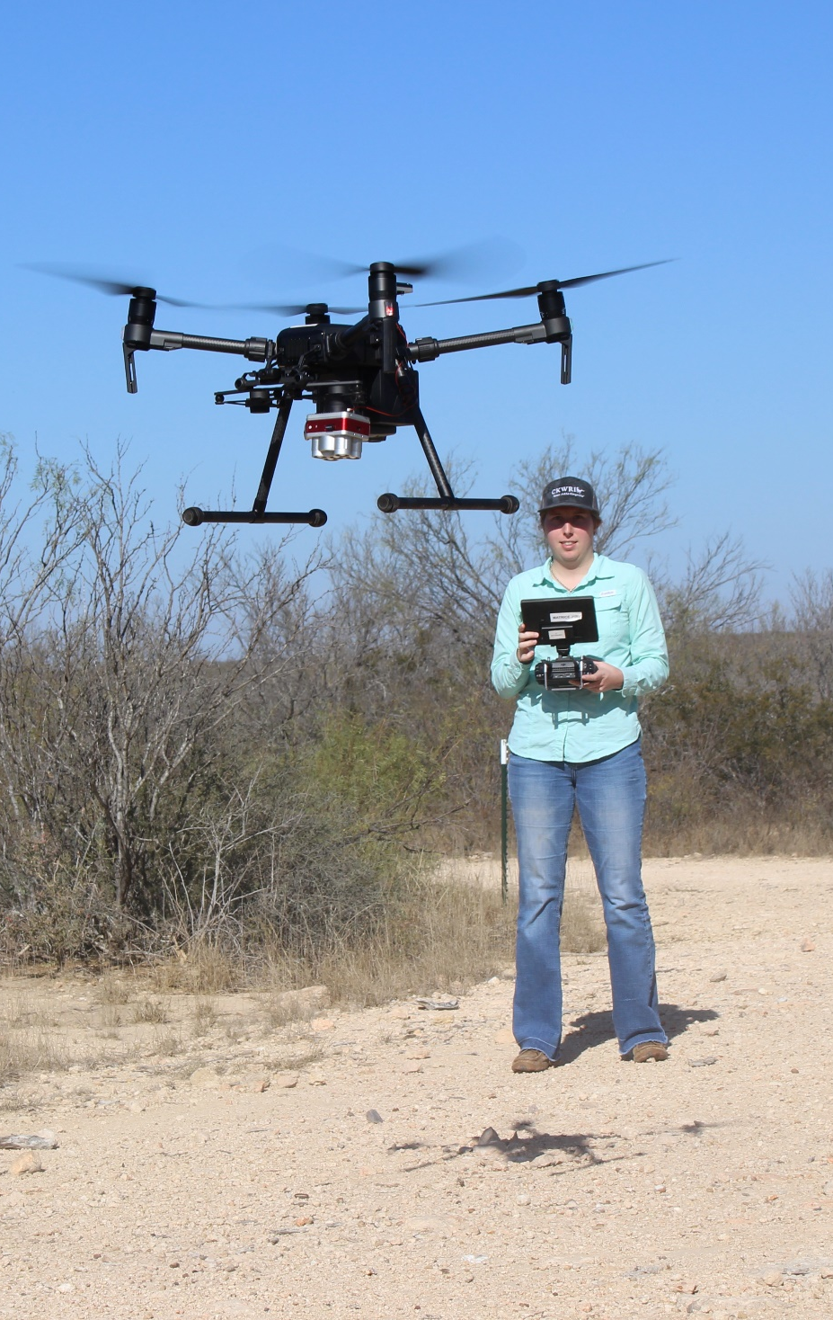
Why the LEAD program?
Drones are the fastest growing market in the geospatial industry.
Drones have change the way data is collected, managed and displayed.
Opportunities in every field: oil industry, conservation, real state, insurance, fire, law enforcement, geospatial intelligence, etc.

Slide 5
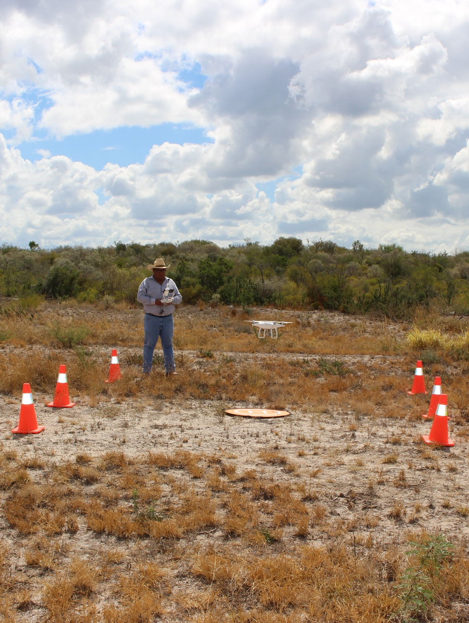
Why the LEAD program in RWFM?
Key to prepare a new generation of competitive professionals in the market.
Huge opportunities in natural resources from research to extension.

Slide 6
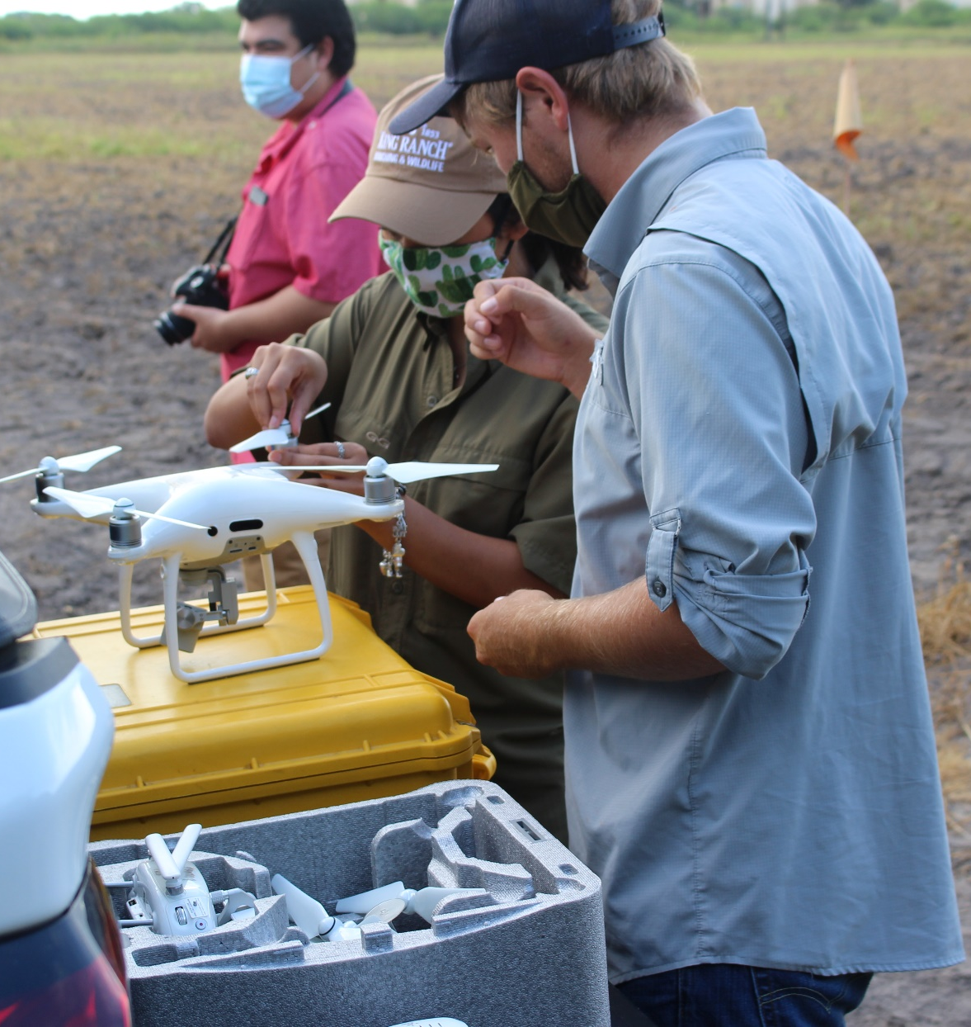
Why the LEAD Program at RWFM?
Drones are becoming an important component of the toolbox for the range and wildlife professional
More and more ranches are routinely adopting geospatial technologies, including drones.
Over 1000 scientific articles on wildlife and drones to date.

Slide 7
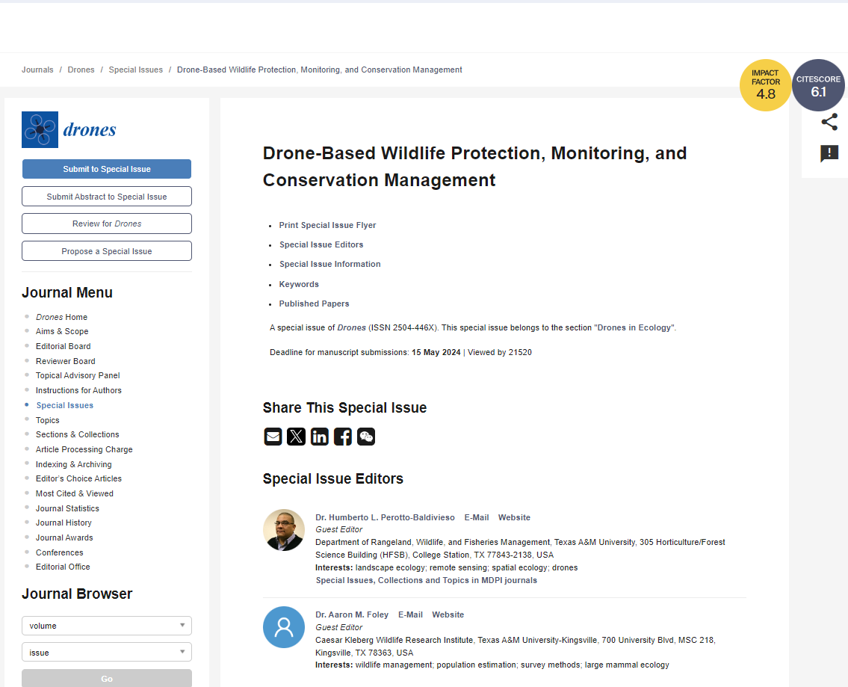
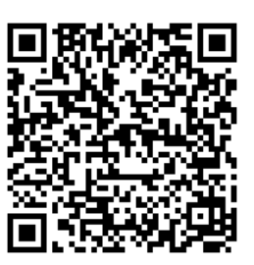
Special wildlife issue
https://www.mdpi.com/journal/drones/special_issues/EN8375JE1F

Slide 8
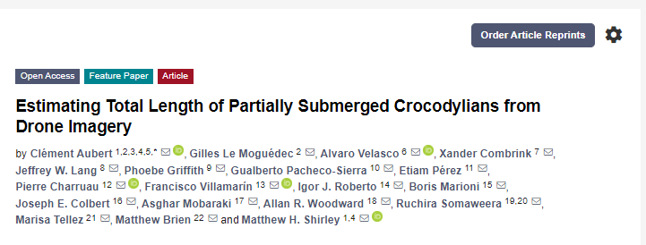
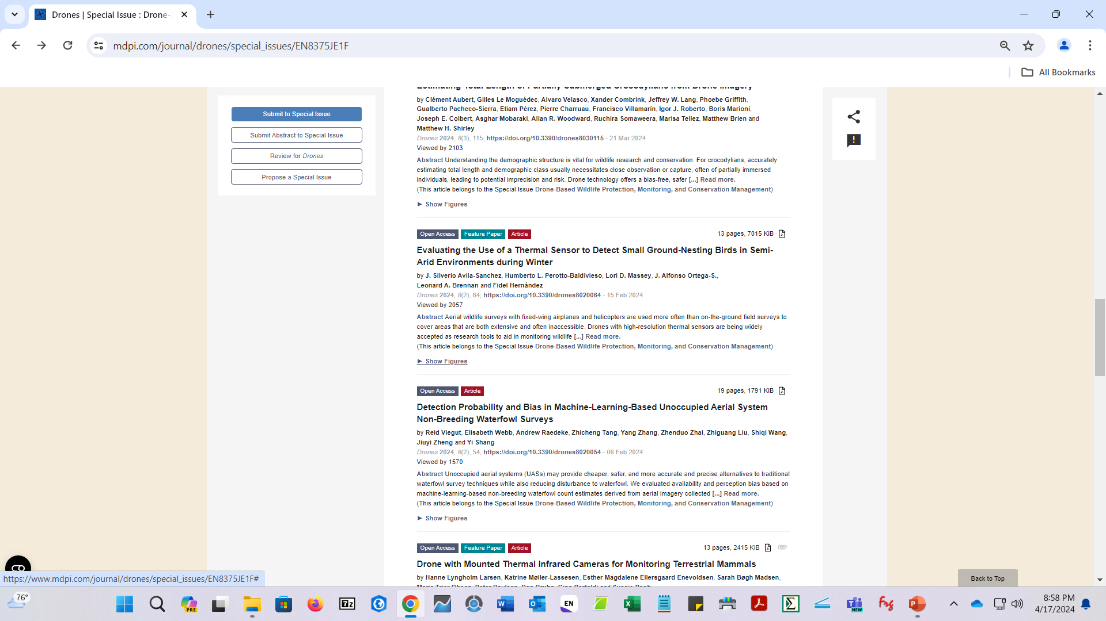
Special wildlife issue

Slide 9
Invasive Species in Rangelands
Invasive annual grasslands are spreading globally.
This increase has negative consequences for wildlife and livestock.
Livestock: decreased forage availability.
Wildlife: habitat reduction particularly grassland birds.
It seems there is no silver bullet to address this problem.
Need of a long-term strategy with a sustained investment in adaptive management and research.
(Mata et al. 2018, Schroeder et al. 2022, Wied et al. 2020)

Slide 10
Management Strategies and Approaches
Management strategies:
Pyric herbivory.
Herbicides.
Fencing.
Restoration Strategies.
Approaches:
Geographic Information Systems.
Remote Sensing.
Landscape ecology.

Slide 11
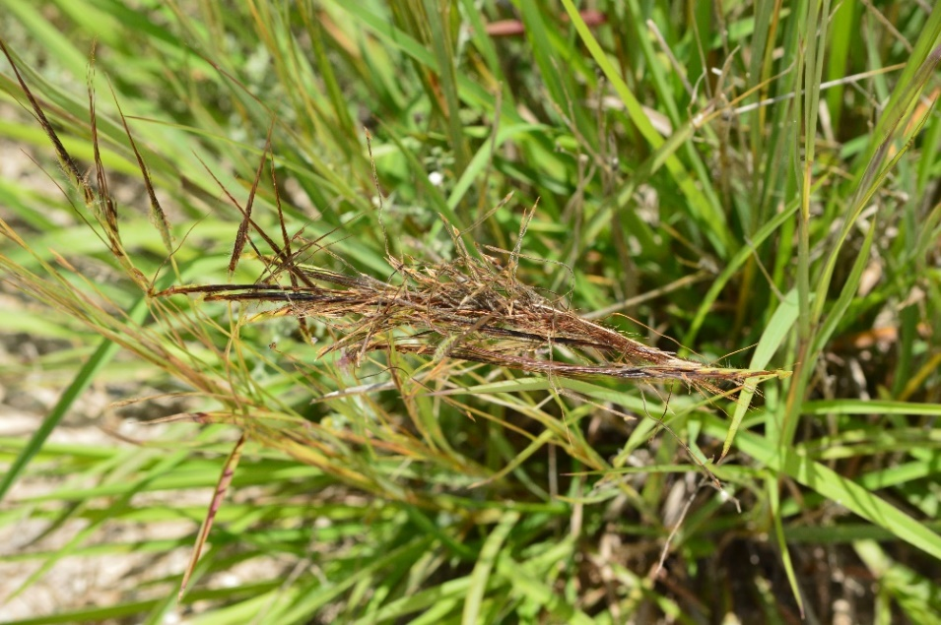
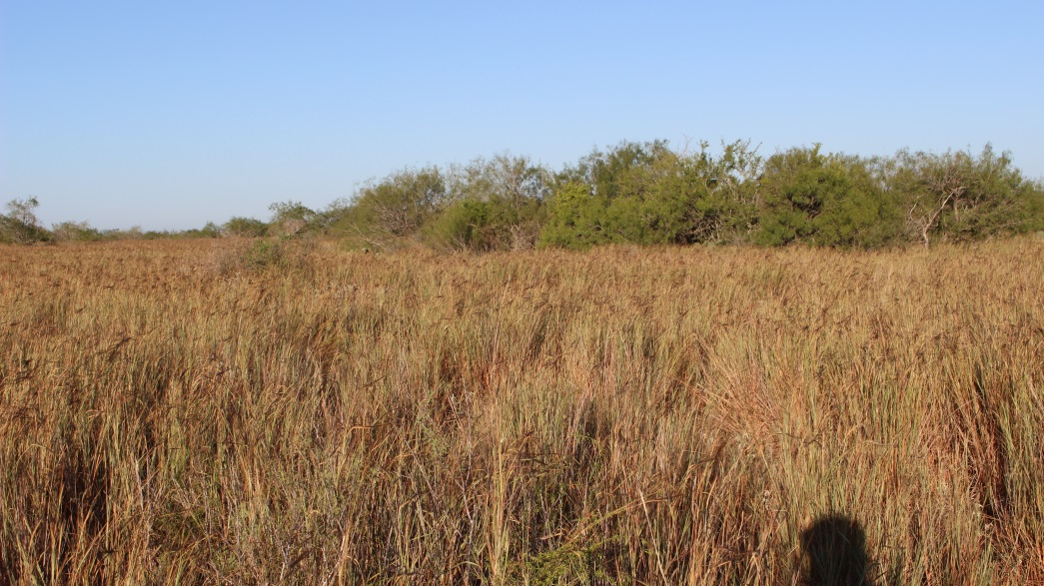
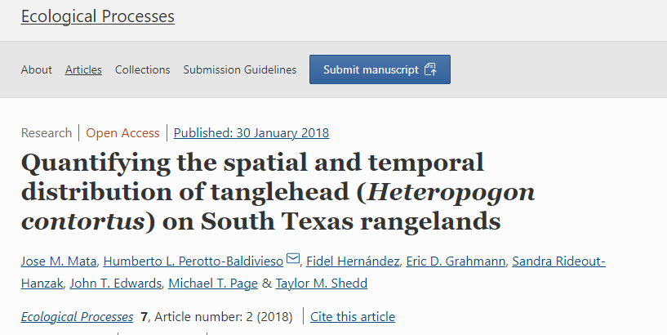
Quantifying Tanglehead With Remote Sensing
Tanglehead (Heteropogon contortus) is a perennial grass native.
It is displaying characteristics more indicative of an invasive.
Prefer sandy soils.
Increased encroachment by this species is a growing concern among ranch managers and landowners.
Photo: Geospatial Technologies Laboratory - CKWRI
Photo: Geospatial Technologies Laboratory - CKWRI
Mata et al. 2018

Slide 12
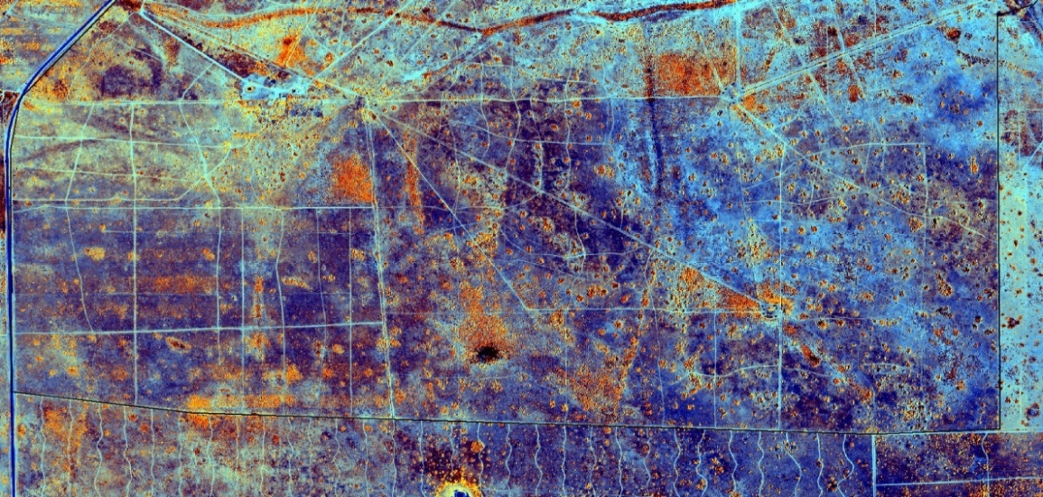
Quantifying Tanglehead With Remote Sensing
Can we map tanglehead using aerial imagery?
Can we use this model to look at tanglehead cover configuration over time?
Can we integrate soils data and tanglehead mapping?
Mata et al. 2018

Slide 13
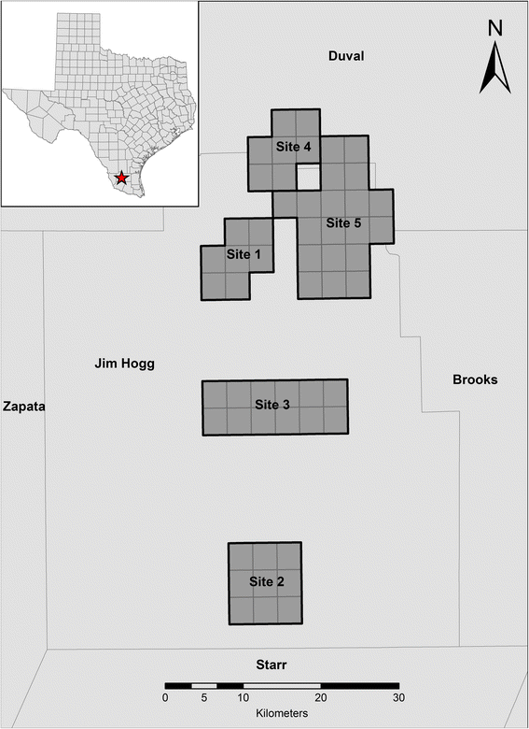
Quantifying Tanglehead With Remote Sensing
Five sites located in Jim Hogg and Duval Counties, part of the Coastal Sand Sheet sub-ecoregion of Texas.
The soil composition in this area is diverse, ranging from deep sandy and course sandy soils to clay-loam soils.
Vegetation in this area consists of mostly grassland and shrubland savannah species.
Mean annual precipitation ranges from 500 to 810 mm.
Mata et al. 2018

Slide 14
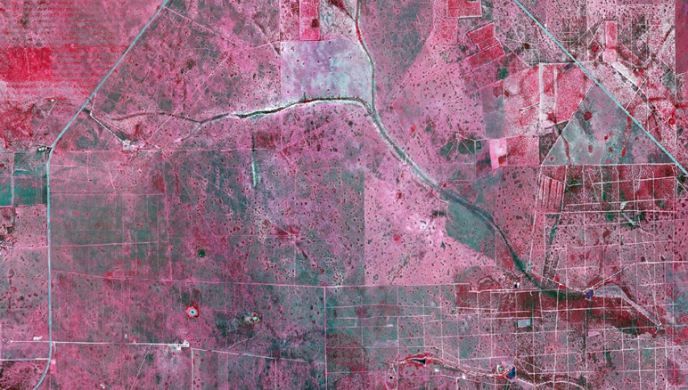
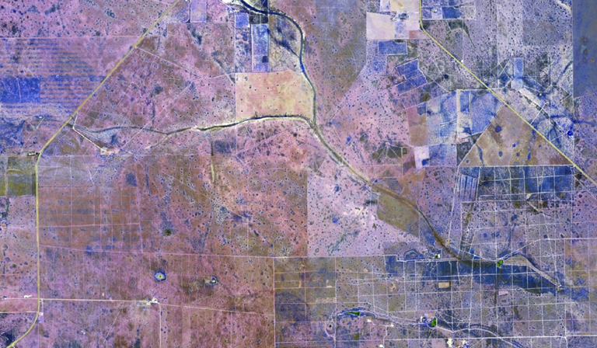
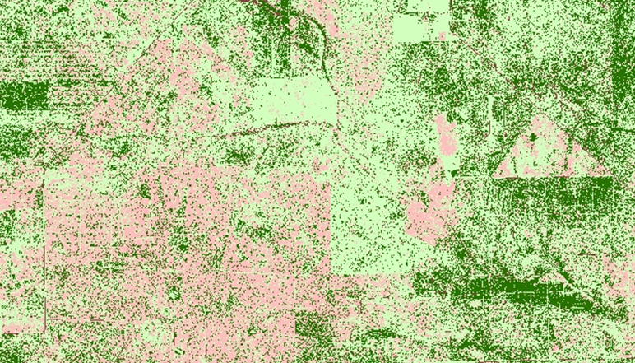
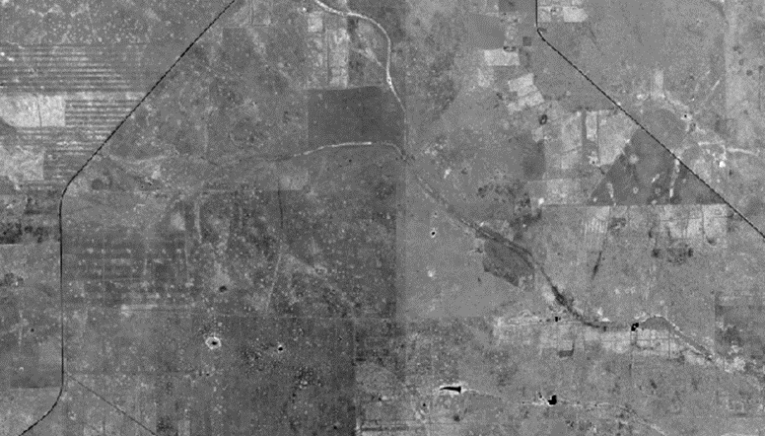
Quantifying Tanglehead With Remote Sensing
NAIP 1- meter Color-Infrared (NC-CIR) Aerial Image
NC-CIR Imagery merged with NDVI
Classified Image
2014 Imagery: 1,423 ground control points were collected for each site to assess classification accuracy.
Overall accuracy for each classification was 86.1%, 85.4%, 89.5%, 88.2%, and 85.6% for sites 1,2,3,4 and 5 respectively.
Process repeated for 2008-2010-2012
Normalized Difference Vegetation Index (NDVI)
Imagery: National Agriculture Imagery Program (NAIP) 1-meter color infrared aerial photography (TNRIS)
Mata et al. 2018

Slide 15
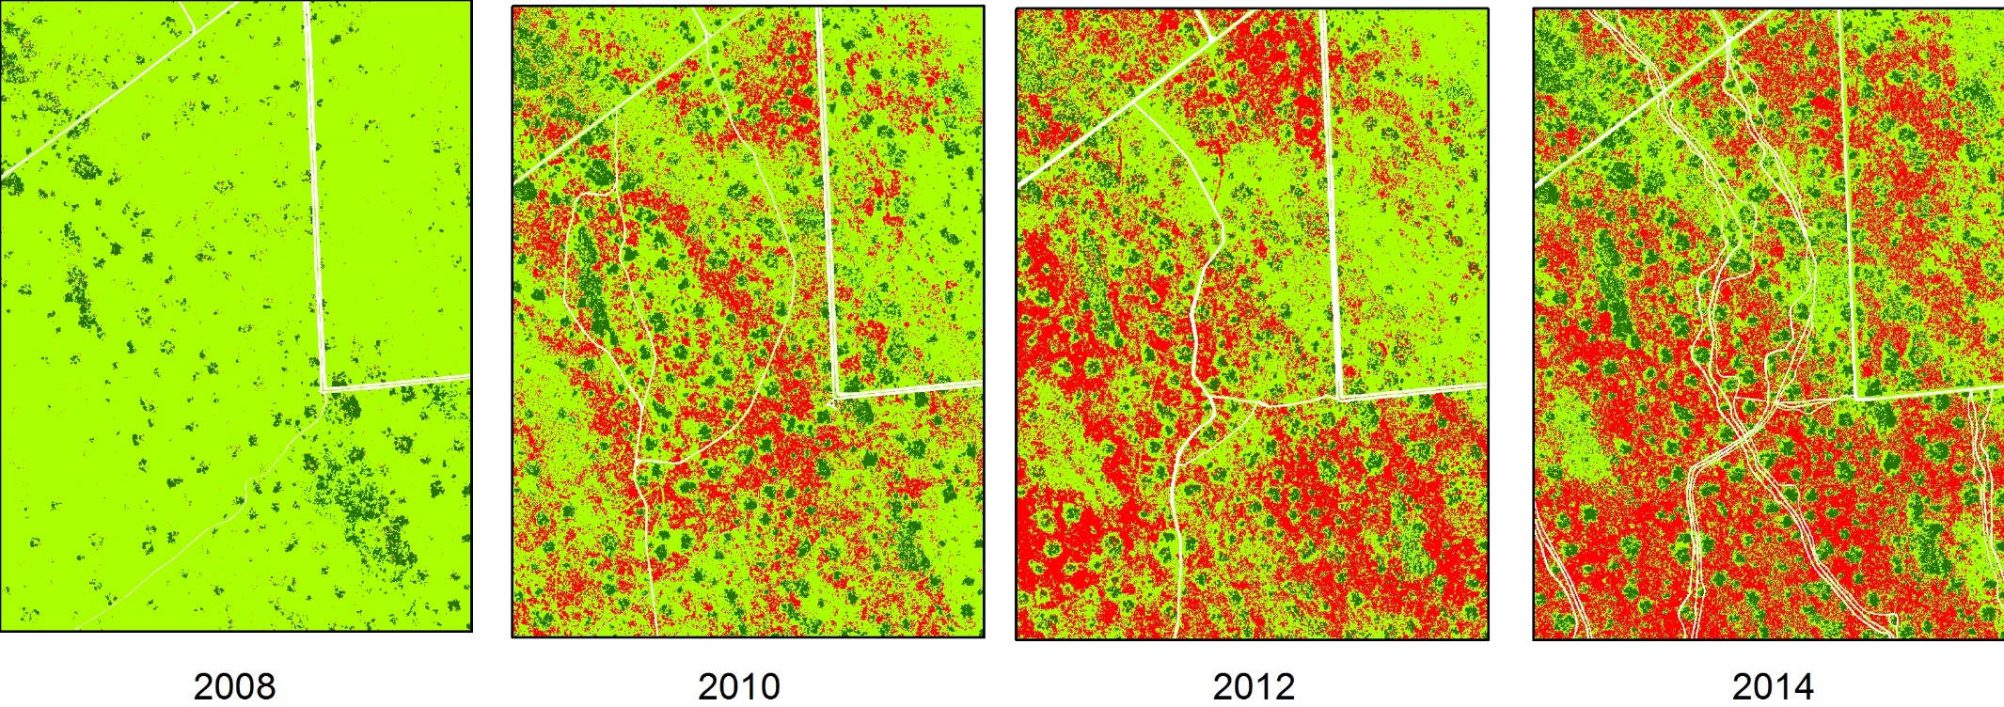
Quantifying Tanglehead With Remote Sensing
Classified land cover between 2008 and 2014 in South Texas. Red represents tanglehead, dark green represents woody cover, light green represents herbaceous (non-tanglehead), and yellow represents bare and roads.
Mata et al. 2018

Slide 16
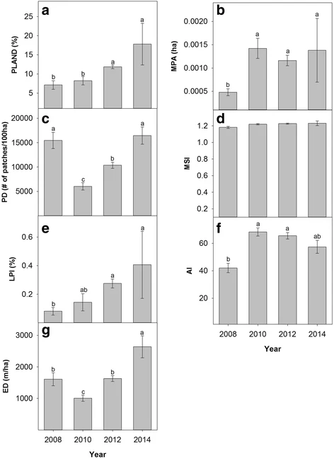
Quantifying Tanglehead With Remote Sensing
Landscape metrics describing the spatial structure of tanglehead in the five study sites in South Texas: percentage cover (a), mean patch area (b), patch density (c), mean shape index (d), largest patch index (e), aggregation index (f), and edge density (g). Error bars represent standard error.
Mata et al. 2018

Slide 17
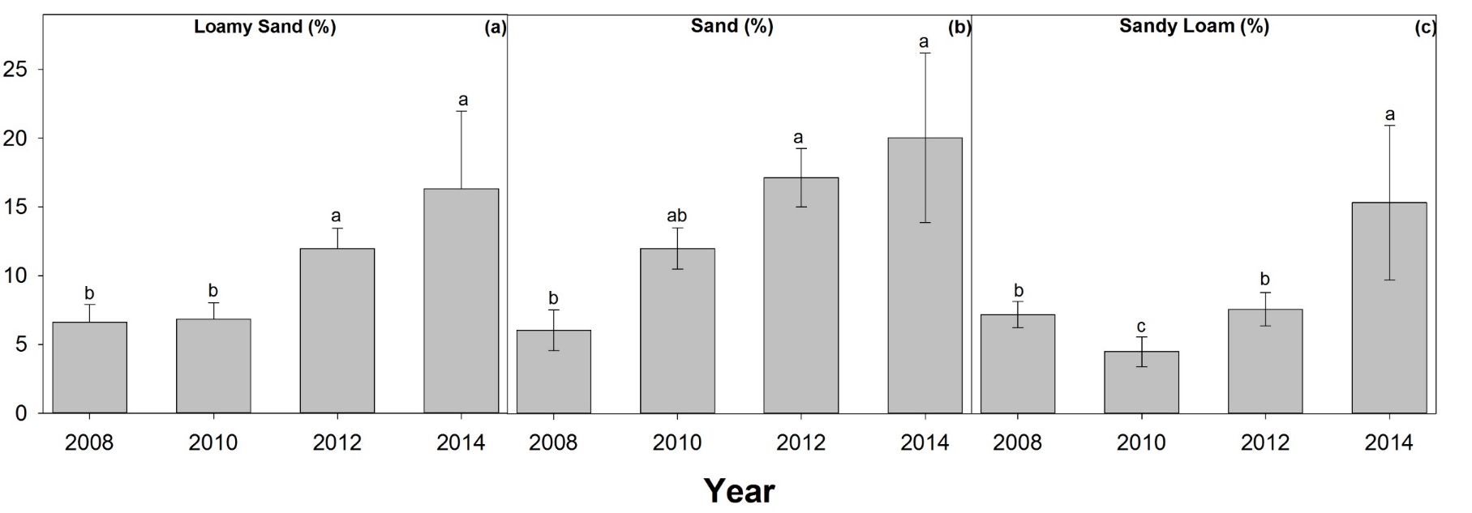
Quantifying Tanglehead With Remote Sensing
Relationship between tanglehead cover (%) and loamy sand (a), sand (b), and sandy loam (c) soil textural classes in Jim Hogg and Duval Counties in the Coastal Sand Sheet of South Texas, USA. Error bars represent standard error.
Mata et al. 2018

Slide 18
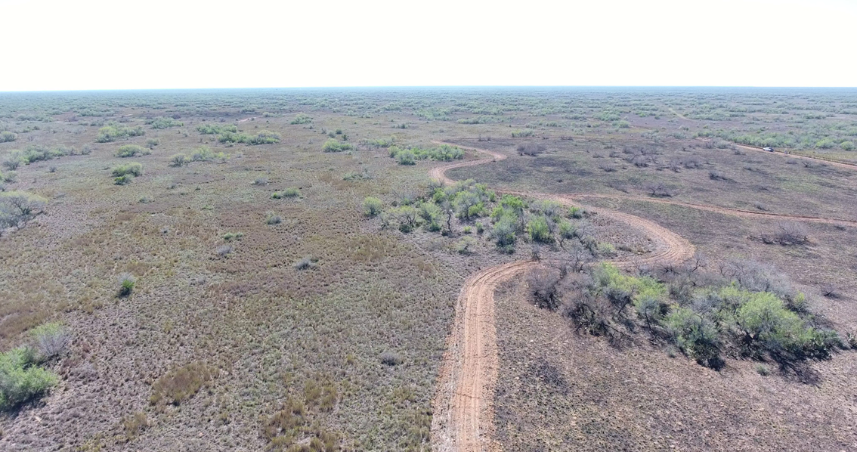
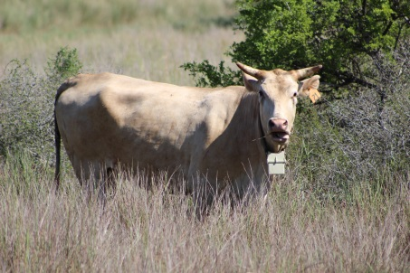
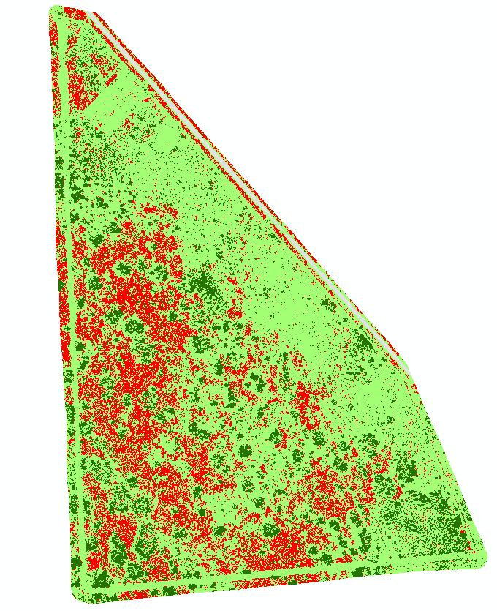
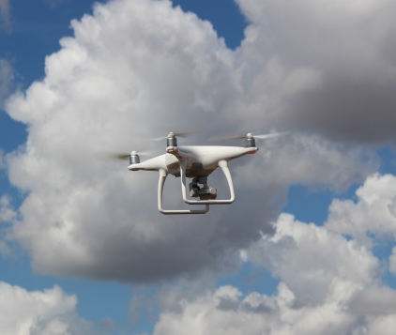
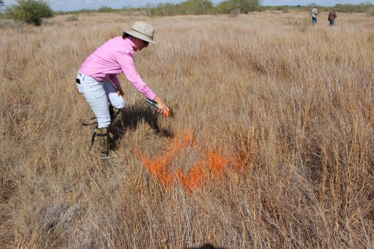
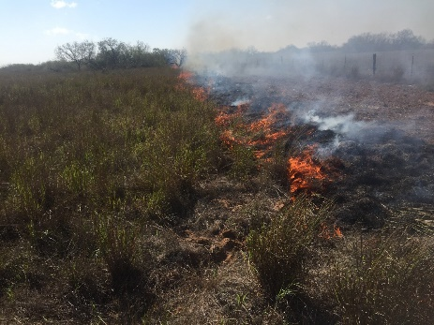
Data Integration to Manage Tanglehead
We can integrate GPS technology, geographic information systems, remote sensing and landscape ecology to improve management strategies of invasive species.

Slide 19
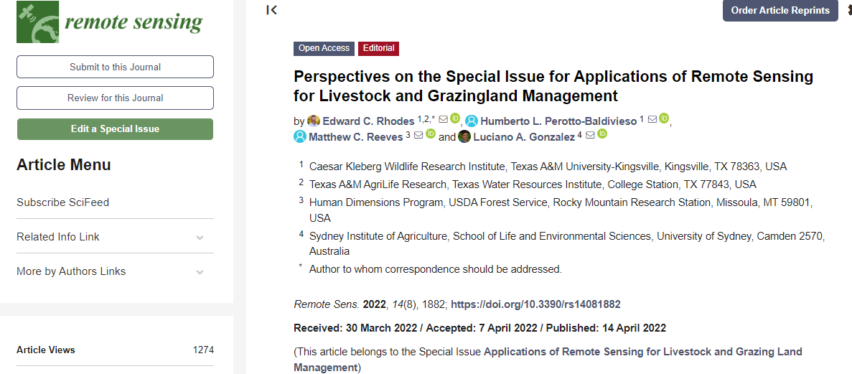
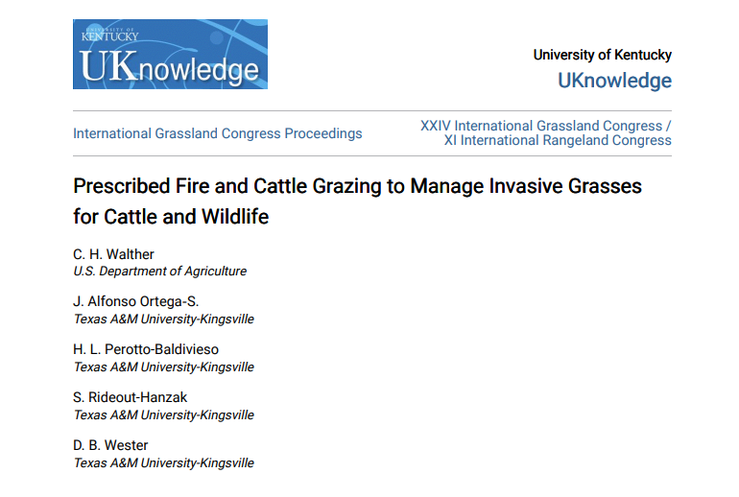
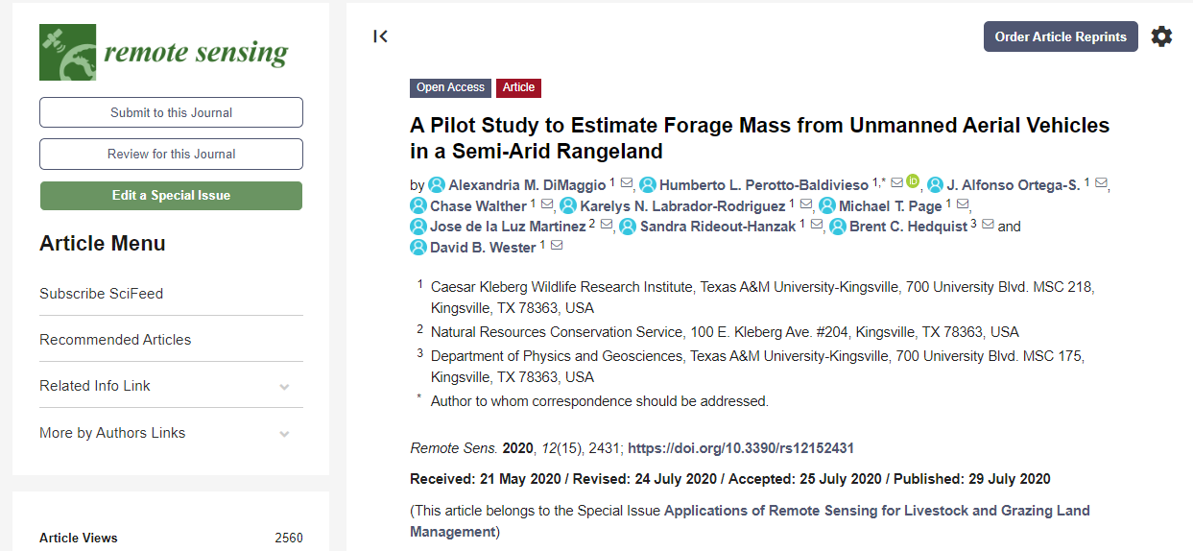
New Ideas, New Opportunities
New ideas
Can we calculate the amount of available forage?
Can we quantify mesquite?
Can we estimate crude protein form drones?
New acquired technology:
Multispectral sensors
Thermal sensors
New interests:
Thermal ecology
Drone aerial surveys
Biodiversity
Fine scale landscape structure

Slide 20
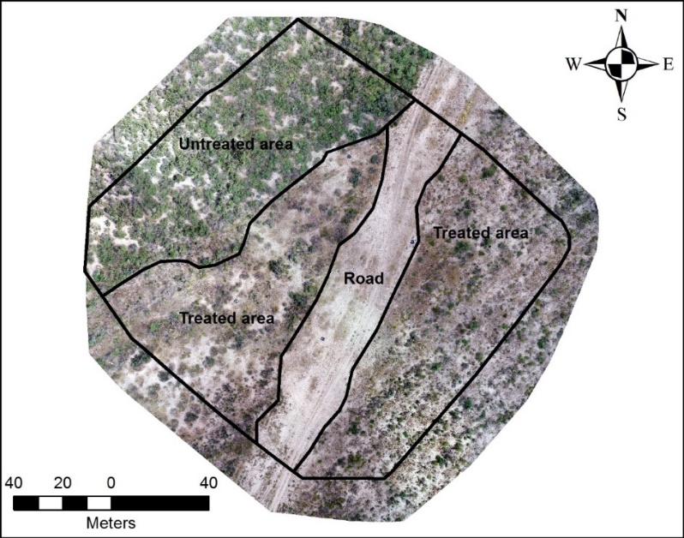
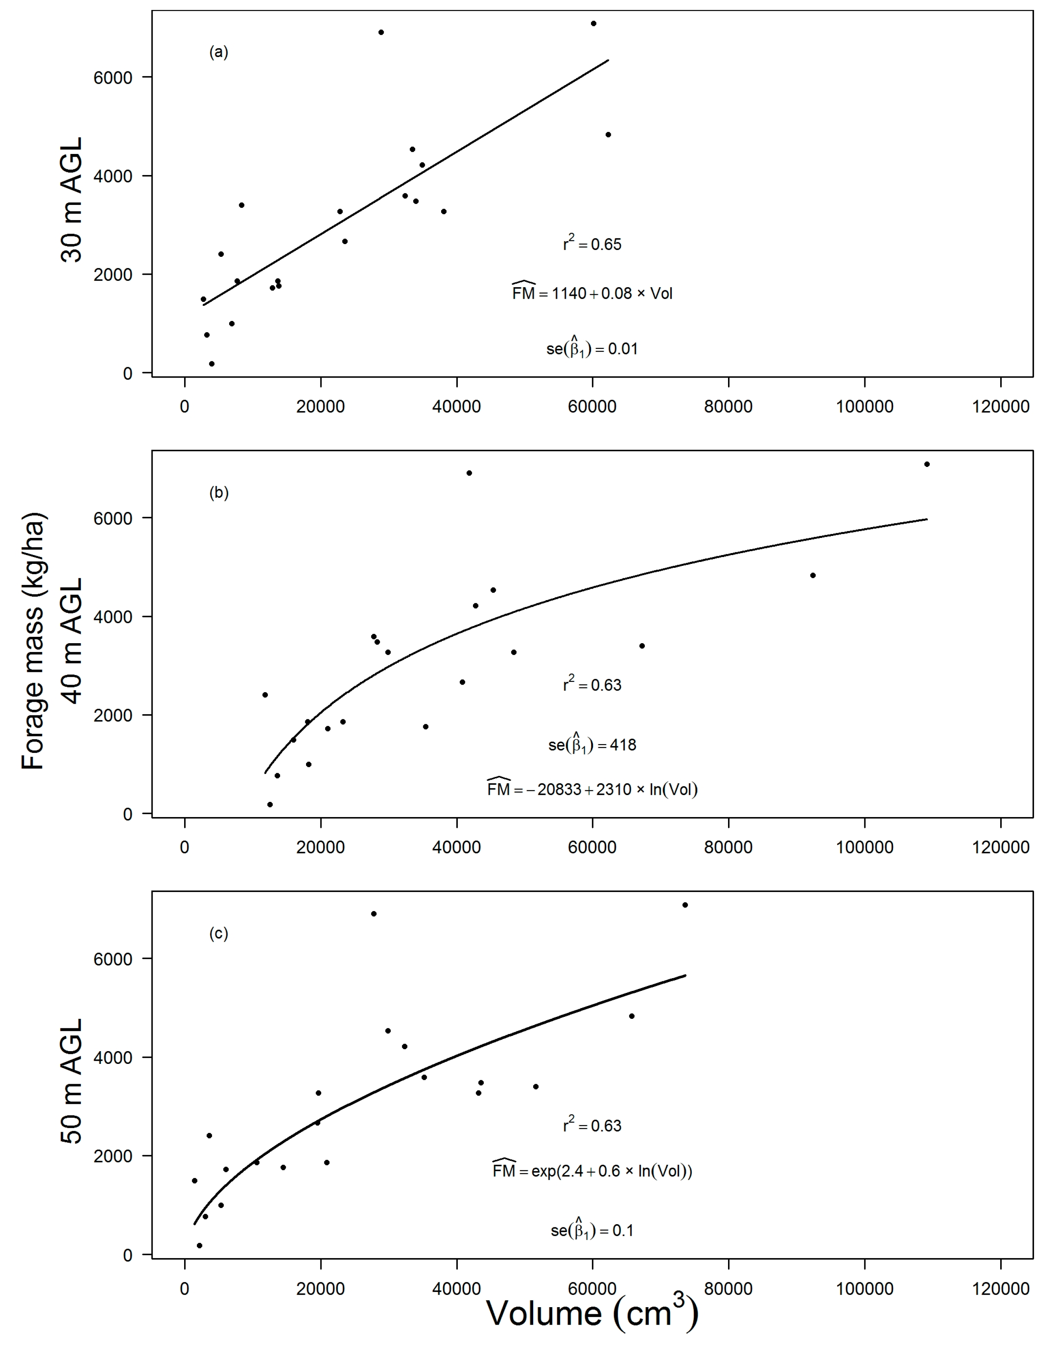
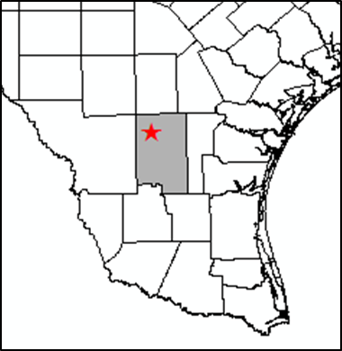
Estimating Forage Biomass with Drones
Regression analysis between forage mass and 3D model volumes from imagery obtained at Duval County Ranch in Duval County, TX, 31 August 2018. Coefficient of determination (r²) and standing forage crop production equation containing estimated regression coefficients are shown for linear-linear regression analysis at 30 m AGL (a), linear-log regression at 40 m AGL (b), and log-log at 50 m AGL (c). AGL denotes height above ground level.
DiMaggio et al. 2020

Slide 21
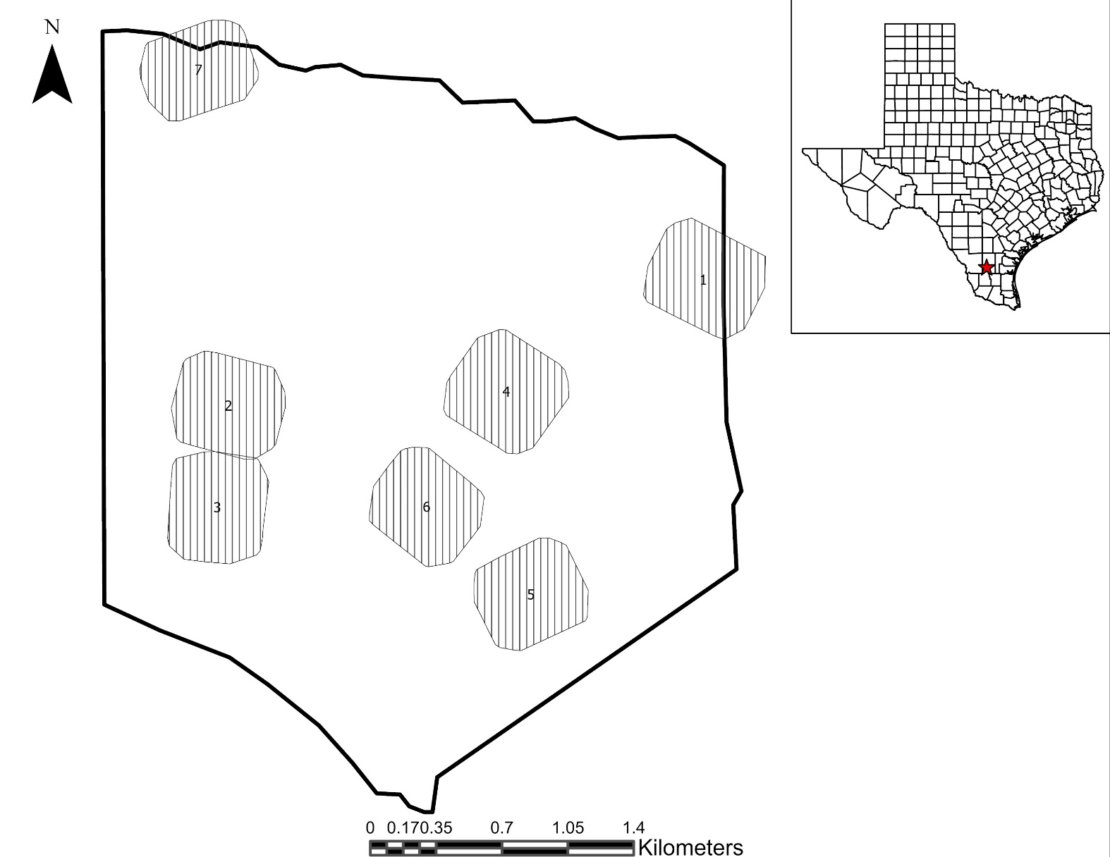
Estimating Forage Biomass with Drones
Locations of seven study sites in Duval County, TX, USA. The lined gray areas represent areas covered by Unmanned Aerial Vehicle imagery for each study site. The thick black line outside the sites represents the pasture boundary. Inset shows state of Texas, USA and approximate location of study area.
Page 2021

Slide 22
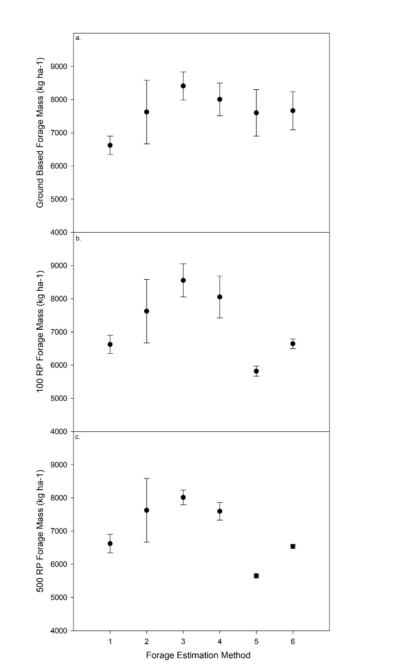
Estimating Forage Biomass with Drones
Scatter Plot with 95% Confidence Intervals comparing forage mass values between forage estimation methods (1 = double sampling method; 2 = vegetation clipping method; 3 = unmanned aerial vehicle (UAV) and double sampling method at 50 m above ground level (AGL); 4 = UAV and double sampling method at 100 m AGL; 5 = UAV and vegetation clipping method at 50 m AGL; 6 = UAV and vegetation clipping method at 100 m AGL) with ground-based data only (a), 100 random points per site (b), and 500 random points per site (c). RP = random points. * represents significant differences at alpha < 0.05.
Page 2021

Slide 23
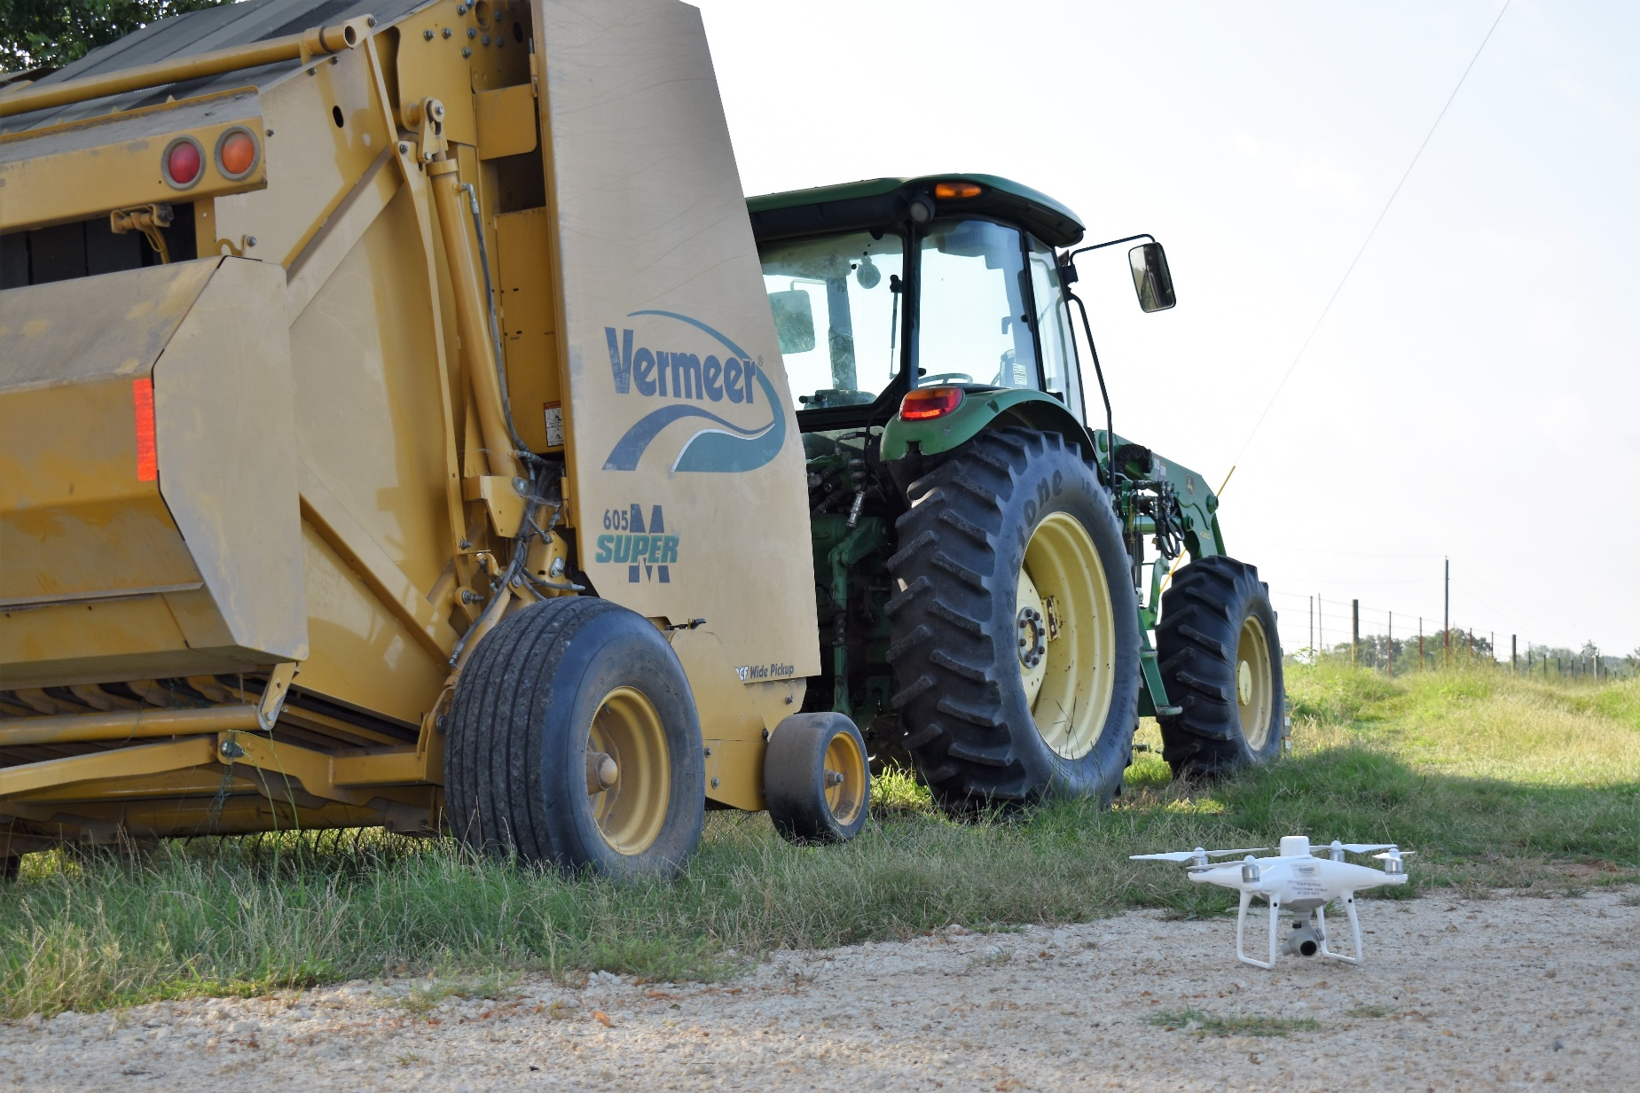
Estimating Forage Biomass with Drones
Photo by Lori Massey
Massey 2023

Slide 24
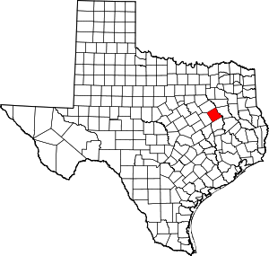
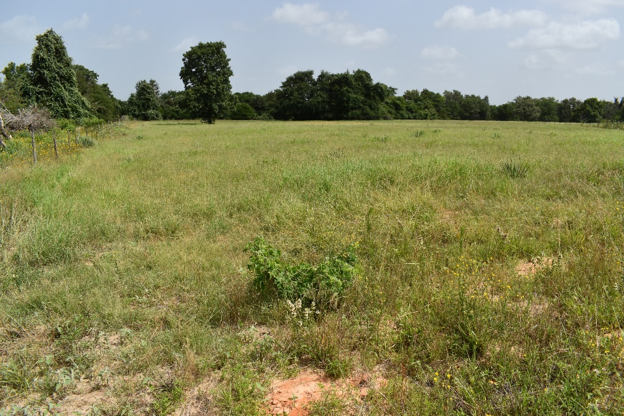
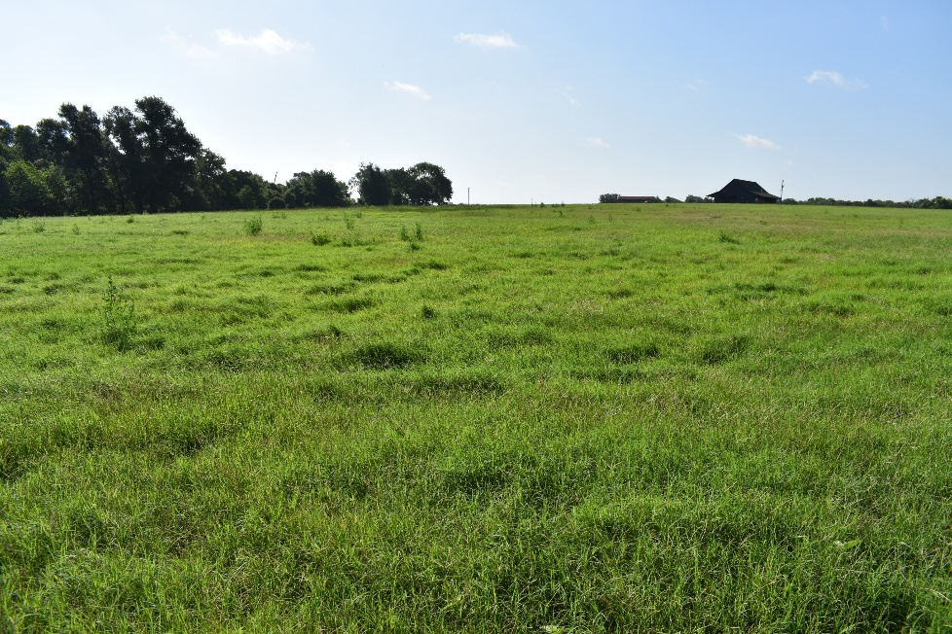
Estimating Forage Biomass with Drones
Post Oak Savanah ecoregion
Freestone County, TX
Annual rainfall is 1,075 mm a year
Annual temperatures range from 12°C to 25°C
Massey, Preliminary Results

Slide 25
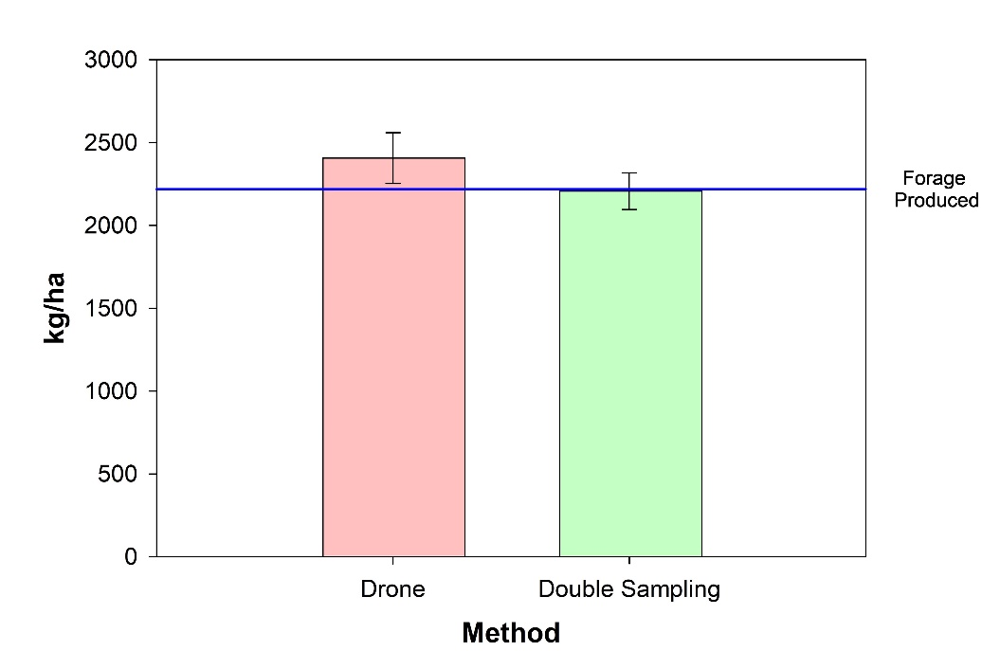
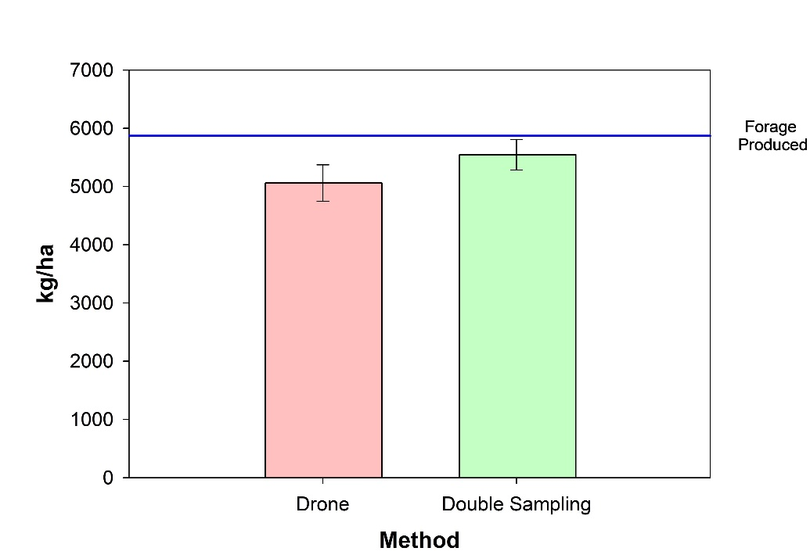
Estimating Forage Biomass with Drones
Actual: 2,219 kg/ha
Drone: 2,406 ± 153 kg/ha
Double Sampling: 2,207 ± 110 kg/ha
Actual: 5,871 kg/ha
Drone: 5,060 ± 312 kg/ha
Double Sampling: 5,546 ± 261 kg/ha
Massey Preliminary Results

Slide 26
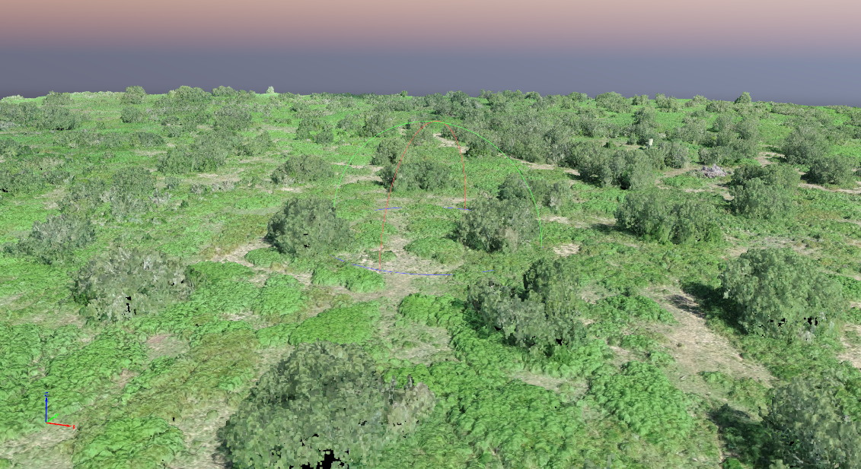
Quantifying Wildlife Habitat with Drones
Very high resolution.
2D and 3D products.
High temporal revisit times.
Potential for improved sampling strategies.
Small areas (<300 Ha).
Gleason and Avila, preliminary results

Slide 27
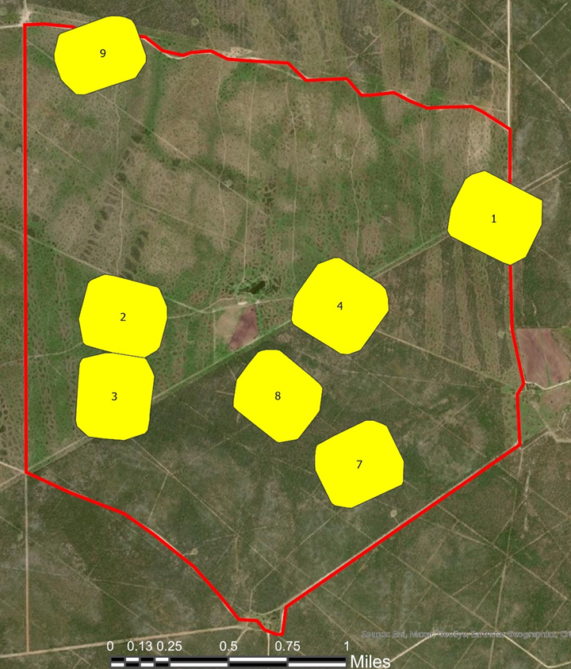
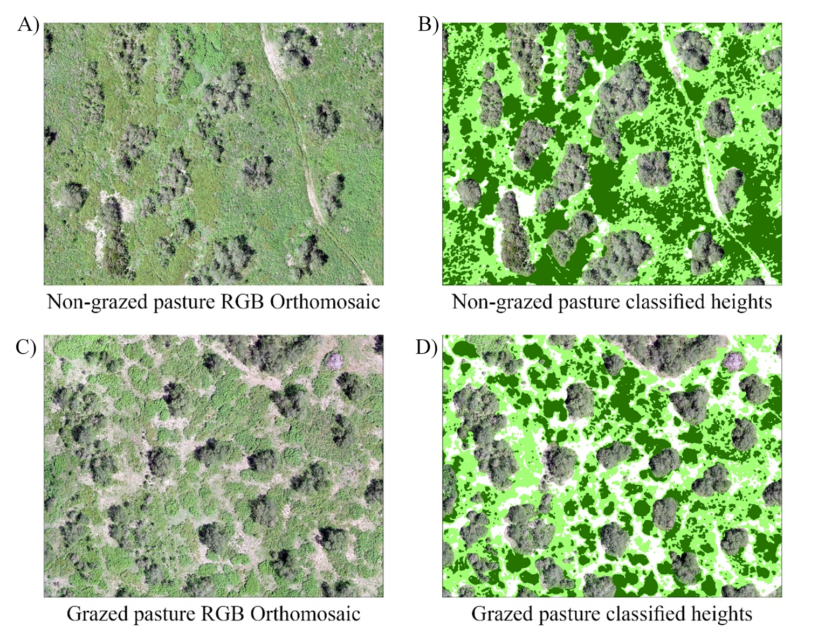
Quantifying Wildlife Habitat with Drones
Changes in habitat for wildlife with livestock grazing:
0-5 cm: bare soil (light yellow)
5-30 cm: grazed herbaceous (light green)
> 30 cm ungrazed herbaceous (dark green)
Potential for improved sampling strategies.
Gleason and Avila, preliminary results

Slide 28
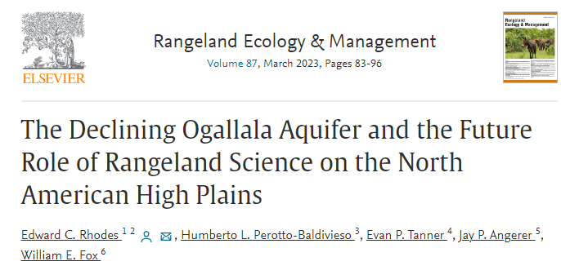

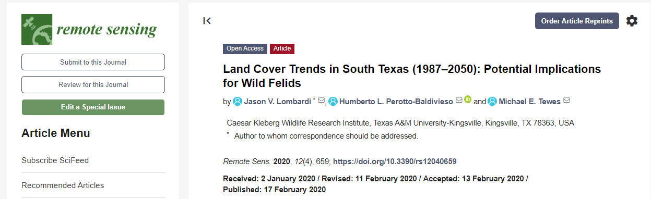
Broad Scale and Multiple Scale Projects

Slide 29
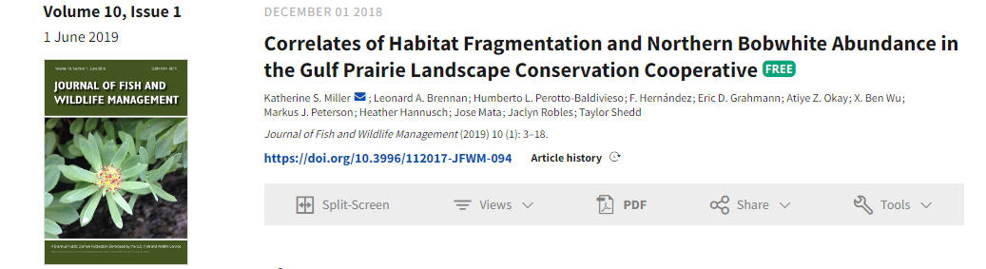
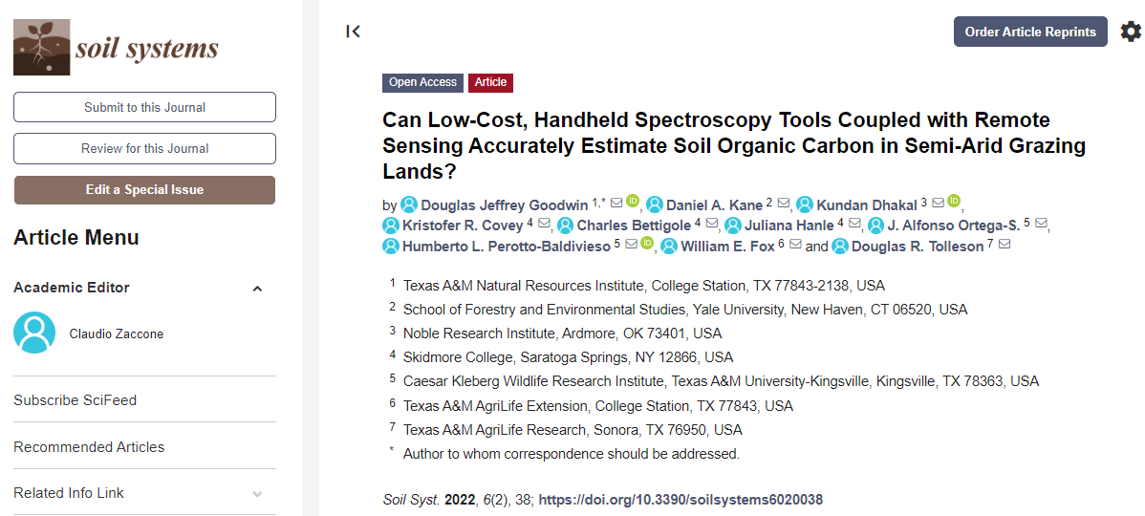
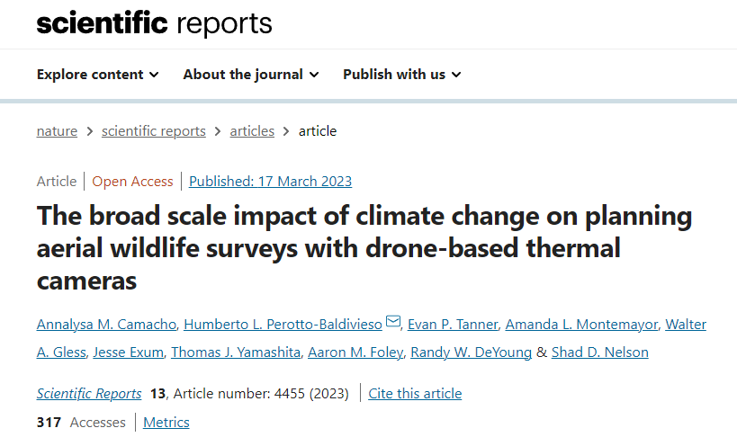
Broad Scale and Multiple Scale Projects

Slide 30
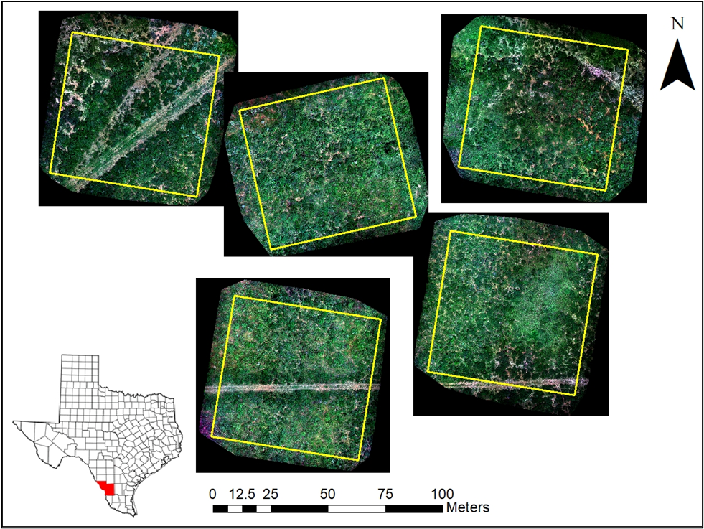
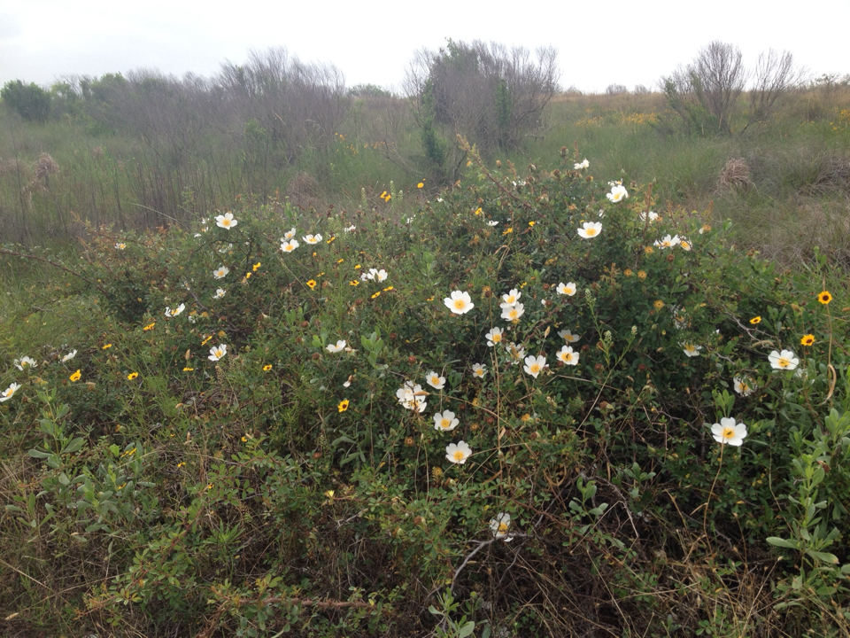
Next Steps
Integrating drones with satellite imagery.
Include native species phenological stages.
Incorporate management into image classification.
Integrate human dimensions into pattern and process.
Implement land cover trends with land cover patterns and processes.
Carbon models for rangelands.
Spatial and temporal dynamics of invasive species.

Slide 31



Next steps
Very high resolution mapping (1/5 inch)
Image classification
3D analysis
Wildlife Aerial surveys
2D and 3D Visualization
Videography
Biomass estimation

Slide 32

Undergraduate Research Opportunities
GIS and drone training.
Internship opportunities.
Hands-on research
Employability
Student success
Land Grant Mission

Slide 33


Undergraduate Research Opportunities
NRCS: Advancing Career Opportunities for student with training in Spatial Data Science
NRCS grant # NR183A750015C017

Slide 34
THANK YOU!
Funding for this projects were provided by:
Texas A&M Agrilife
Coastal Prairie Conservancy
The Houston Livestock Show and Rodeo
Dallas Safari Club
The Harvey Weil Rotary Club of Corpus Christi
Rene R. Barrientos Educational Assistance Fund for Wildlife Graduate Students
Ken Leonard Fund for Cattle Wildlife Interactions
NRCS grant # NR183A750015C017
National Science Foundation CREST Grant #2019-38422-25543
USDA Grant 2021-68018-34634
South Texas Chapter of the Quail Coalition
Vaughan Foundation
Mr. Rob Stacy from Houston, TX
Thank you to all the colleagues, graduate and graduate students who worked hard to make these projects possible.
We are in deep gratitude to the landowners in Texas and partners who graciously granted us access to their properties.

Slide 35

Questions?

Slide 36
Key considerations for a successful drone program
Safety
Program/project objectives.
Team effort.
Understanding of laws and regulations.
Continuous training for all pilots (software/hardware/regulations).
Protocol development for drones safety and fleet management.
Development of a strategy to have continuous funding.
Long-term planning.

Slide 37
Important regulations to follow
Federal regulations
Part 107
FAA regulations
USFWS regulations
State regulations
Regulations over urban areas
Texas Parks and Wildlife Department
University regulations
Drone policies
Risk management
Insurance
Compliance.

Slide 38


Hardware and software
Batteries
Replacement propellers
Anemometers
Cones
Strobes
Flashlights
night light systems
Two-way radio communications

Slide 39

Planning your flights
Weather conditions
Risk management forms
Pilots and visual observers
Software and hardware updates
Drone maintenance checklist
Mission planning
Batteries
Equipment checkout
Folder checkout

Slide 40

Mission planning
Flight altitude
Flight area
Time of the year
Ambient temperature
Topography
DiMaggio et al. 2020

