Slide 1

Ally for Instructors
By Eric Nambo – EIR Accessibility Coordinator, Equal Opportunity Services

Slide 2
Course Description
Ally for Instructors
With Blackboard Ally, ensuring and providing an accessible learning experience is now easier than ever. This workshop covers Blackboard Ally: what it is, what is does, and how to use it. Learn all the features of Ally, the user interface within Blackboard, and how to use the tool to identify and fix accessibility issues with course content.
Learning Objectives
Summarize the features of Blackboard Ally
Identify the user interface components
Understand the types of feedback generated
Review fundamental workflows for producing accessible content
Explore solutions to common accessibility issues
Notes:
Hello everyone. I’d like to welcome you to this workshop, Ally for instructors.
My name is Eric Nambo. I'm the University of Houston System EIR Accessibility Coordinator in Equal Opportunity Services.
Let's take a look at the course description.
With Blackboard Ally, ensuring and providing an accessible learning experience is now easier than ever. This workshop covers Blackboard Ally: what it is, what is does, and how to use it. Learn all the features of Ally, the user interface within Blackboard, and how to use the tool to identify and fix accessibility issues with course content.
Learning objectives for this Workshop are to
Summarize the features -- of Blackboard Ally to learn what it can do,
Identify the user interface components of Ally – so that you know how to use each button and screen,
Understand the types of feedback generated -- by the tool so that you can better fix and prioritize issues.
Review the fundamental workflows for producing accessible content – to feel comfortable manipulating file formats,
And lastly – Explore Solutions for common accessibility issues.

Slide 3
Sections Outline
Core Features
Ally User Interface
Accessibility Feedback
Fundamental Workflows
Accessibility Solutions
Conclusion
Notes:
This workshop is broken into 6 sections that mirror the learning objectives.
So let’s begin the Ally for Instructors workshop.

Slide 4
SECTION 1: Core Features
Accessibility Feedback (Scores)
Improve Content Accessibility
Alternative Formats
Notes:
Core Features. In this section, we're going to look at the core functionality and features that Blackboard Ally provides to both instructors and students.
These core features include
accessibility feedback or accessibility scores,
coaching for improving content accessibility,
and generating alternative formats.

Slide 5
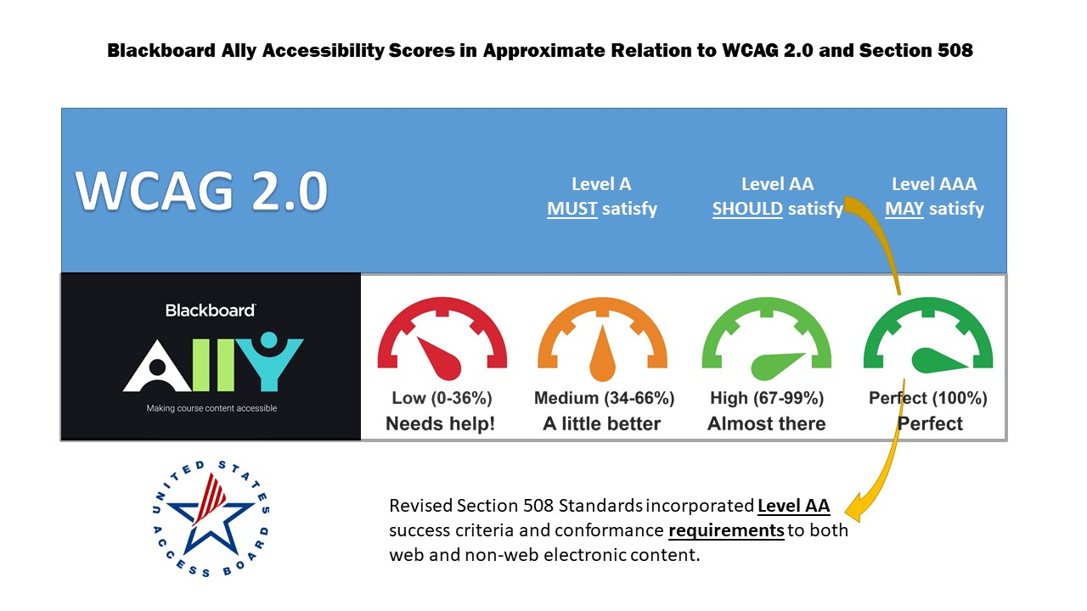
a. Accessibility Feedback (Scores)
Applies to both new and existing content
Content assigned a numerical number and a corresponding color gauge
Viewed inline (by file)
Viewed overall (by course)
Green is compliant*
Notes:
The first feature is accessibility feedback or scoring. Accessibility scores are applied to both new and existing content in your course. Files are assigned a numerical score and a corresponding colored gauge, indicating the accessibility score.
In a moment, I'll explain these colors and how they align with compliance.
These accessibility scores can be found next to each file in your course (in line). Alternatively, the overall score for your course can be viewed in the Course Accessibility Report.
Our goal for accessibility is get your content into the green.

Slide 6
Score Alignment with Section 508
Notes:
So why green?
This graphic shows how Blackboard Ally scores roughly align to Section 508 compliance standards.
Understand that Section 508 has been updated to reflect the W-C-A-G 2.0 accessibility standards.
The top blue row shows the three levels of conformance:
Level A, AA, AAA
Section 508 requires that content meet Level AA.
Continuing on to the next row, Ally has four different colors for accessibility scores:
Red, orange, light green and dark green. For the sake of simplicity, we'll say that
Red does not meet WCAG Level A
Orange meets Level A
Light green meets Level AA
and dark green meets AAA
Keep in mind that update to the federal standard that requires content meet Level AA. For that reason, we will say define compliant as light green. In short, go for green!

Slide 7
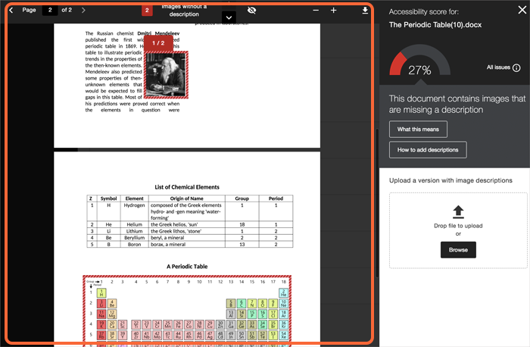
b. Improve Content Accessibility
Some content can be fixed in Blackboard
Other content has to be fixed and re-uploaded
Support articles are available from Blackboard and instruction.uh.edu
Assistance available from accessibility@uh.edu
Notes:
The next feature is coaching to improve content accessibility.
Some content can be fixed within Blackboard using the instructor feedback panel, which we'll get to later.
Other content has to be fixed and re-uploaded using the instructor feedback panel.
Support articles are available from Blackboard and from instruction.uh.edu.
If you get stuck feel free to send an email to me at accessibility@uh.edu.

Slide 8
c. Alternative Formats
SUPPORTED FORMATS
GENERATED ALTERNATIVES*
PDF files
Microsoft® Word files
Microsoft® PowerPoint® files
OpenOffice/LibreOffice files
Uploaded HTML files
OCR’d version (for scanned documents)
Tagged PDF (currently for Word, PowerPoint and OpenOffice/LibreOffice files)
Mobile-friendly HTML
Audio
ePub
Electronic Braille
Translated Version
*some features not enabled
Notes:
The last feature, and one that is incredibly valuable to our students, is generating alternative formats.
Ally will take your course content files and produce alternative formats for students with disabilities. For example, in the left column are supported file formats that can generate alternative content.
These include PDF and Microsoft Office documents, as well as uploaded HTML files. Ally will take those file and generate alternative formats listed in the right column; such as screen reader friendly OCR PDFs for scanned documents and tagged PDFs. It also makes mobile-friendly HTML pages, MP3 read aloud files, ePub’s for Kindle, and even electronic Braille for students that use refreshable braille displays.

Slide 9
SECTION 2: Ally User Interface
Course Accessibility Report
Accessibility Scores
Instructor Feedback Panel
Notes:
Section 2: Ally User Interface. In this section, we will look at the different components you can interact with in Ally. These components include the course accessibility report, the content accessibility scores, and the instructor feedback panel.

Slide 10
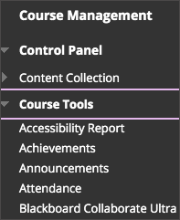
a. Course Accessibility Report
Course Management > Course Tools > Accessibility Report
Summary of course accessibility
Overview Tab
Course score
Content grouped by type
All issues identified
Content Tab
Content with accessibility issues
Notes:
Let's begin with the course accessibility report. You can access this by going to the course management links, expanding the course tools, and clicking on accessibility report.
The accessibility report will provide an accessibility summary of your course, as well as two tabs; the overview tab, which shows the course score, your content grouped by type, and all issues identified in the course. The content tab shows the content with accessibility issues.
Let's take a closer look in a demo course.

Slide 11
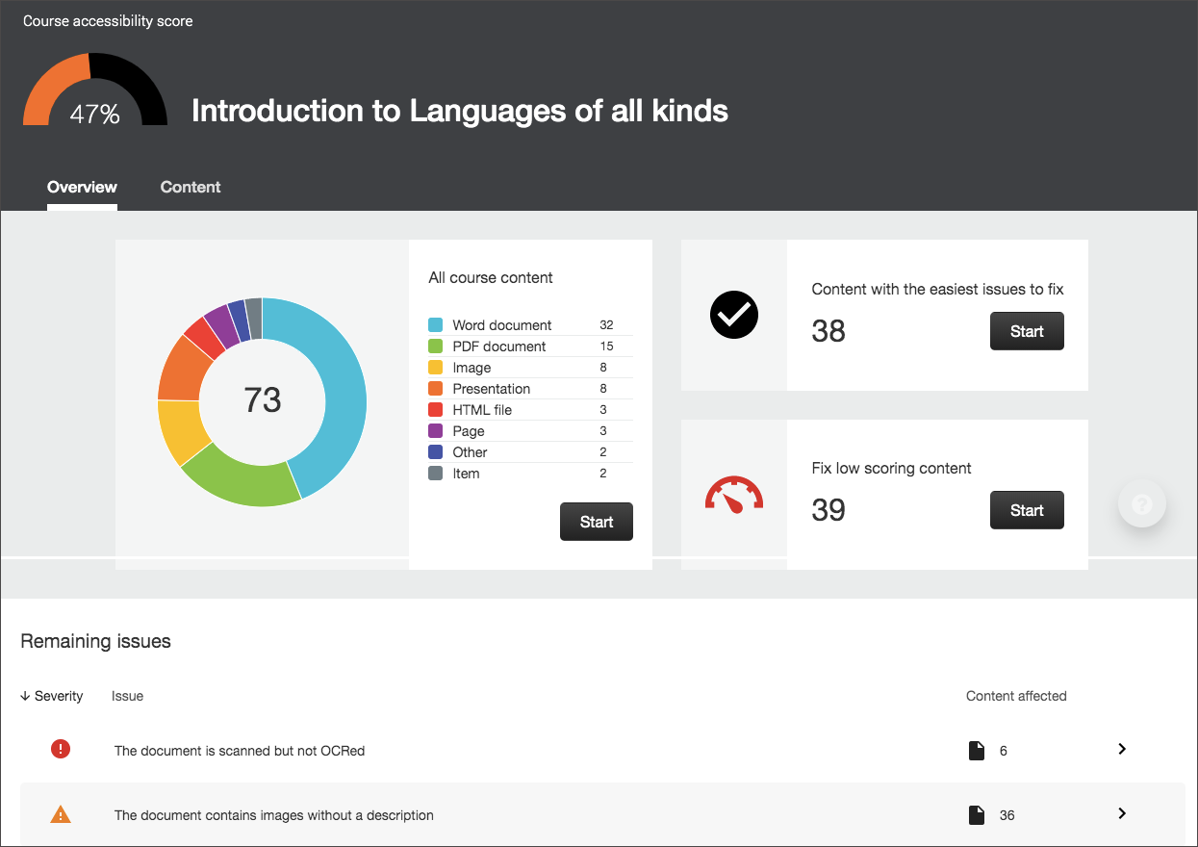
Dashboard – Course Accessibility Report
Notes:
Here is our demo course. Let's review how to get to the course accessibility report. From the course home, navigate to the course management links. Then we will expand the course tools section and click on accessibility report.
Here's our accessibility report for the course.
At the top we can see our course accessibility score. By default The overview tab will be loaded. We can see three cards. The first card shows chart displaying all the course content grouped by file type.
The next card displays a prompt with the number of easy issues to fix. The last card displays a prompt with prompt with the number of low-scoring content to be fixed. You can click start on either card to begin working on improving your score.
Towards the bottom of the report is a list of all the remaining issues in the course, which can be filtered and sorted by severity and issue.
Scrolling back to the top and toggling the content tab will display all the content with accessibility issues. From this screen we can see all the files with issues and sort files by the number of issues, or the accessibility score.

Slide 12
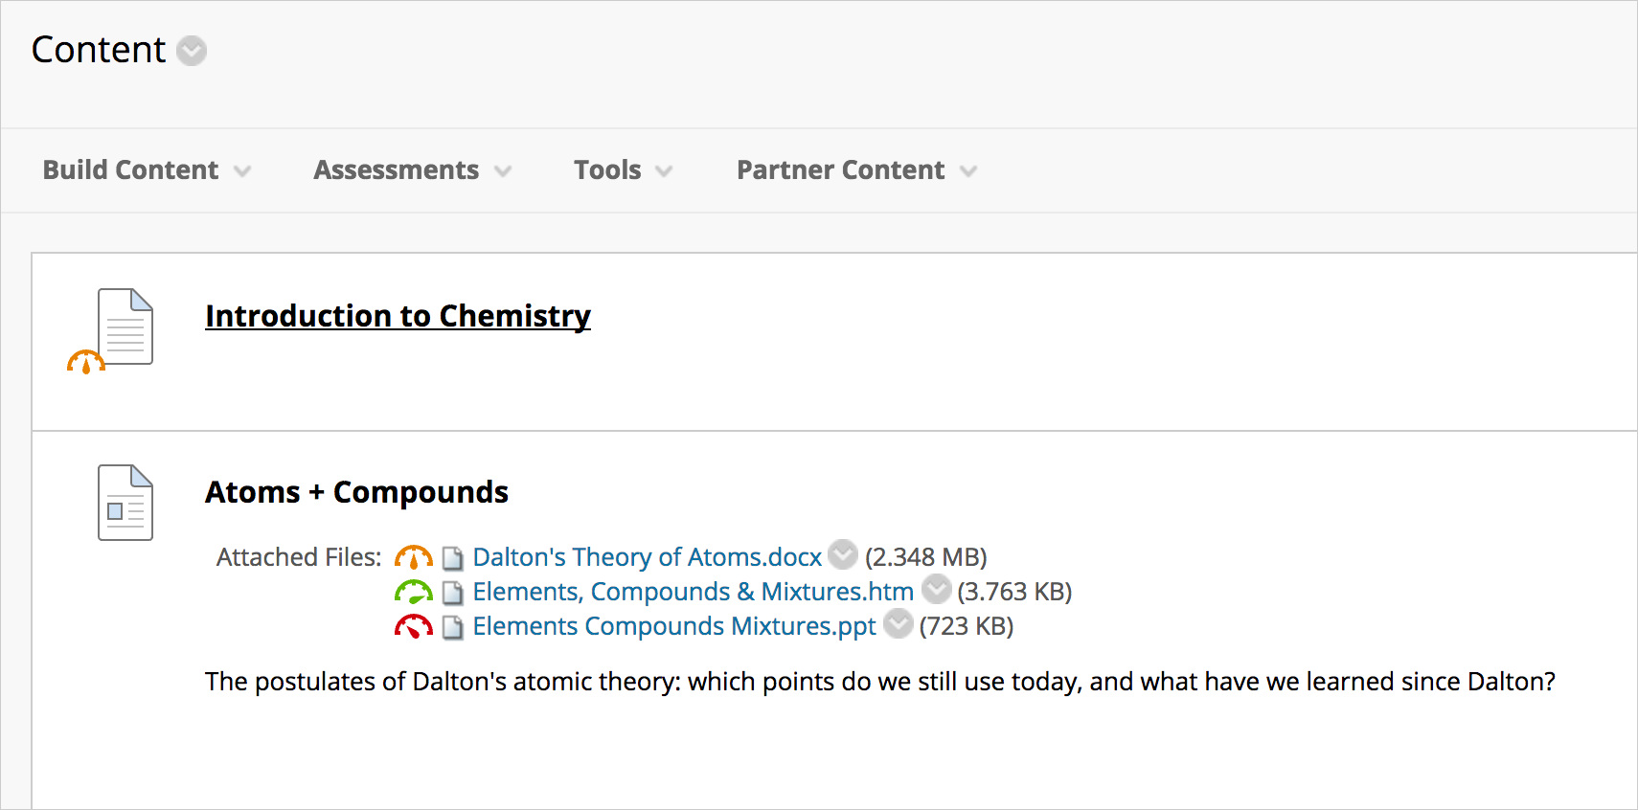
b. Accessibility Scores
Content > Item/File
Inline accessibility scores
Issues are located in "Instructor Feedback"
Click icon to open "Instructor Feedback"
Notes:
The next Ally user interface component we will look at is the accessibility scores. These can be found by navigating to content and looking at a specific item or file. There you will see the inline accessibility score indicator. Click on the colored gauge to view the issues in the instructor feedback panel.

Slide 13
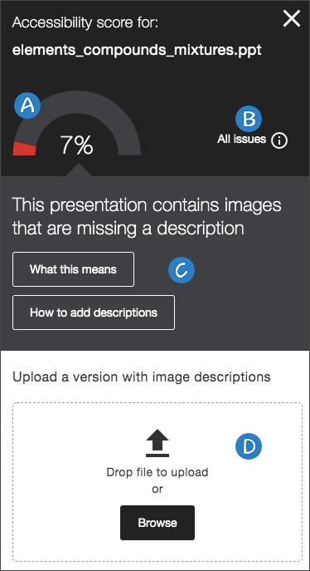
c. Instructor Feedback Panel
Content > Item/File > Icon
Shows issues and step-by-step guidance
Accessibility Score
All issues with document
Issue description & guidance
Upload widget
Notes:
This brings us to the last Ally user interface component, the Instructor Feedback Panel. Again, to access the panel, navigate to a file and click on the colored gauge icon.
The instructor feedback panel shows all the issues and step-by-step guidance for fixing them. Features in the instructor feedback panel include the accessibility score of the content, issues within the content, issue descriptions and guidance for how to make repairs, and the upload widget for uploading the fixed content.
Let's go back to our demo course to see an example of the accessibility scores and instructor feedback panel.

Slide 14
SECTION 3: Accessibility Feedback
Supported file formats
Common issues
Notes:
Section 3: Accessibility Feedback. In this section, we'll briefly review the types of files that are scored by Ally. We will reveal some common accessibility issues before diving into later sections that cover Fundamental Workflows and Accessibility Solutions.

Slide 15
a. Scored File Formats
PDF files
Microsoft® Word files
Microsoft® PowerPoint® files
OpenOffice/LibreOffice files
Uploaded HTML files
Image files (JPG, JPEG, GIF, PNG, BPM, TIFF)
WYSIWYG/VTBE content
YouTube (embedded)
Notes:
Although Ally is a new and promising tool, it has its limitations. Keep in mind that not every single type of file format is scored. The following is a list of file types analyzed by Ally.

Slide 16
b. Common Issues
Frequent Issues
Issues at UH
Add image descriptions
Add headings to a document
Fix text contrast
Scanned PDFs
Tag a PDF
Color contrast, docs
Image alt text, docs
Untagged PDF's
Missing headings, docs
Image alt text, WYSIWYG
Notes:
However, this list provides plenty of issues to work on. The right-hand column listed common issues seen across all institutions using Ally. These include
Missing image descriptions
Missing headings
Poor color contrast
Unscanned PDFs
And untagged PDFs
These common issues identified by Blackboard closely match some of the issues discovered here at University of Houston. The left-hand list is an example of the most frequently identified errors found in the institutional accessibility data for the University of Houston.
The most common accessibility issue is color contrast in documents. This means that the text and background color of a document does not have a high enough contrast.
The second most common issue is missing alternative text for images in documents. The third most common issue is using untagged PDFs. This occurs when a PDF is “flat,” as in, it has no semantic features like headings.
Coming in fourth is missing headings in documents, which can be related to untagged PDF’s.
Lastly on the list is alt text for images in Blackboard. This issue arises when an image has been uploaded in Blackboard without adding alt text. It can be a serious problem when the image is a photo of a document!
With an understanding of what Blackboard Ally checks and common issues seen by Blackboard and at University of Houston, we are ready to review the Fundamental Workflows for creating accessible documents.

Slide 17
SECTION 4: Fundamental Workflows
Fundamental Workflow 1 – MSFT Accessibility Checker
Fundamental Workflow 2 – MSFT Word to PDF
Fundamental Workflow 3 – PDF to MSFT Word
Fundamental Workflow 4 – Adobe Acrobat Make Accessible Action Wizard
Fundamental Workflow 5 – Uploading to Ally
Notes:
Section 4: The fundamental Workflows. Before we explore accessibility solutions, it’s important that we understand how to convert files and check for accessibility. In this section we're going to discuss how to use accessibility checking tools and convert documents back and forth between Microsoft Word and Adobe PDF. Then we will show the workflow for how to upload revised documents to Blackboard using Ally.
Note that for each workflow in this section, we will pause on the workflow slide before proceeding to accompanying example slide. This is so you can see the steps written out as well as available resources for each workflow.

Slide 18
a. Fundamental Workflow 1 – MSFT Accessibility Checker
Steps
In the File tab, navigate to the Info pane
In the Check for Issues options, click Check Accessibility
In the Inspection Results pane, find and fix accessibility issues
Additional Resources
"How to Use Accessibility Checker for Microsoft Files," Instruction@UH
http://www.instruction.uh.edu/knowledgebase/how-to-use-accessibility-checker-for-microsoft-files/
"Creating Accessible Microsoft Office Documents," Office of the Texas Governor
https://gov.texas.gov/organization/disabilities/accessibledocs2013-16
Notes:
Fundamental Workflow 1: The Microsoft accessibility checker. On screen are the steps for how to check accessibility for Microsoft Office documents as well as resources for more information.
Next we'll look at the example for how to use the accessibility checker.

Slide 19
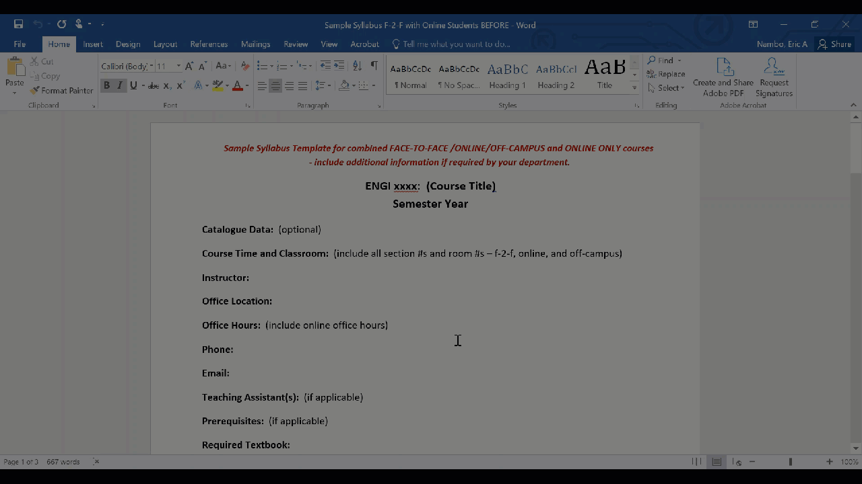
Example – MSFT Accessibility Checker

Slide 20
b. Fundamental Workflow 2 – MSFT Word to PDF
Steps
After using the Accessibility Checker...
In the File tab, click on the Save as Abobe PDF
In the folder menu, click Options
In the PDF options, check:
Create Bookmarks
Convert Word Headings to Bookmarks
Additional Resources
"Converting Documents to PDFs," WebAIM
https://webaim.org/techniques/acrobat/converting
"Create accessible PDFs," Microsoft
https://support.office.com/en-us/article/create-accessible-pdfs-064625e0-56ea-4e16-ad71-3aa33bb4b7ed
Notes:
Fundamental Workflow 2: Exporting Microsoft Word Documents to PDF. This is the key workflow for creating natively accessible documents. A natively accessible document is a fancy way of saying “accessible source document.” This workflow is important because having an accessible source document affords exporting accessible PDFs.
On screen are the steps for how to export Microsoft Word documents to PDF, as well as resources for more information.
Next we'll look at the example for how to execute this workflow.

Slide 21
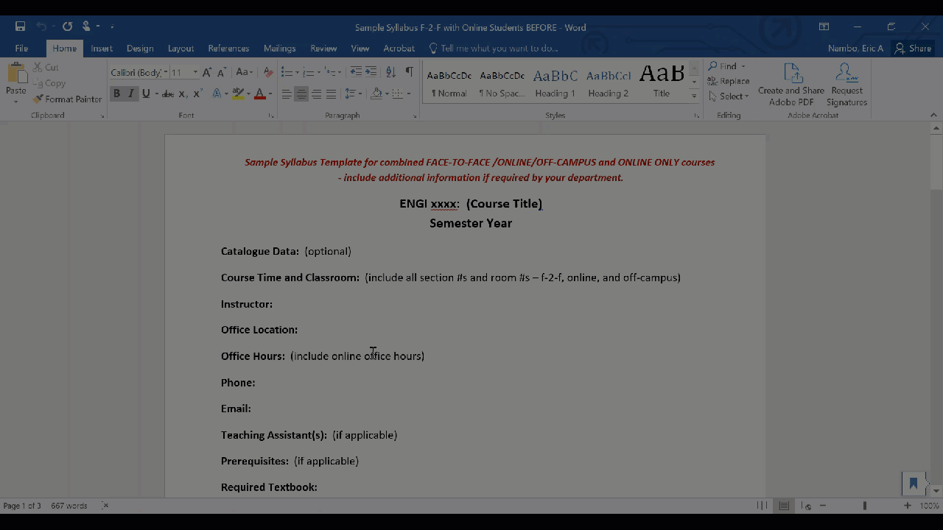
Example – MSFT Word to PDF

Slide 22
c. Fundamental Workflow 3 – PDF to MSFT Word
Steps
In the File menu, click Export To
Select Microsoft Word > Word Document
Additional Resources
"How to Convert PDF to Word," Abobe
https://helpx.adobe.com/acrobat/using/pdf-to-word.html
Notes:
Fundamental Workflow 3: Converting PDF documents back to Microsoft Word. This is workflow is the opposite of Workflow 2. It’s not uncommon to have a PDF, but not the original source file in Word. Creating accessible Word documents is much easier than fixing a PDF, so learning this workflow will allow you to convert documents back and forth between PDF and Word for revising.
On screen are the steps for how to convert PDF documents to Word, as well as resources for more information.
Next we'll look at the example for how to execute this workflow. Note: You will need to use the latest version of Adobe Acrobat Pro DC 2019. It is available to faculty and staff at UH via the software downloads page on the UIT website. Contact you campuses IT office to get a copy.

Slide 23
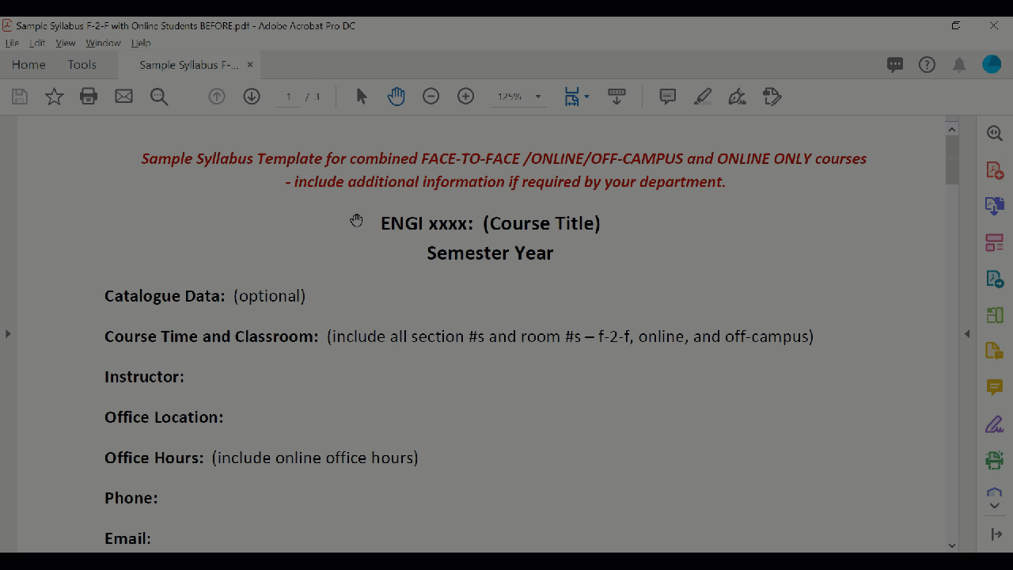
Example – PDF to MSFT Word

Slide 24
d. Fundamental Workflow 4 – Adobe Acrobat Make Accessible Action Wizard
Steps
!Download software from UIT!
Add the Action Wizard from Tools
On the Tools tab, locate the Action Wizard tool (under the Customize heading) and click Add
In the Secondary Toolbar (right-hand pane), click the Action Wizard tool icon
In the Action List, select Make Accessible
Click Start to launch the wizard
Follow the prompts to complete the Make Accessible action
Add Document Description
Recognize text using OCR
Set reading language
Autotag document
Set Alternative Text
Notes:
Fundamental Workflow 4: Adobe Acrobat Make Accessible Action Wizard.
A word of caution – this workflow is a bit more complex than the others. It is advised that you review the knowledge base article tutorial I created on Instruction@UH titled, “How to Fix PDF Accessibility Issues in Adobe Acrobat Pro DC 2019.” You can find the link to that resource on the next slide.
This is action wizard workflow is similar to the Accessibility Checker tool from Microsoft, only it’s more interactive. Not all course content is authored by the instructor. It’s common to find a PDF on the web that must be in your course. In recognition of that, this workflow adds accessibility features to PDFs that can’t practically be converted to Word for revisions.
On screen are the abbreviated steps for how to use the Make Accessible Action Wizard in Adobe Acrobat.

Slide 25
d. Continued
Resources
"How to Fix PDF Accessibility Issues in Adobe Acrobat Pro DC 2019," Instruction@UH
http://www.instruction.uh.edu/knowledgebase/how-to-fix-pdf-accessibility-issues-in-adobe-acrobat-pro-dc-2019-windows-10/
"Create and Verify PDF Accessibility," Adobe
https://helpx.adobe.com/acrobat/using/create-verify-pdf-accessibility.html
Notes:
This slide features the link to comprehensive knowledge base article that explains all the steps in detail with screenshots. Also on screen is a support article straight from Adobe.

Slide 26
e. Fundamental Workflow 5 – Uploading Accessibility Edits to Ally
Steps
Open the Instructor Feedback panel
Drop updated file into the Upload area to replace the original
Notes:
Fundamental Workflow 5: Uploading Accessibility Edits to Ally. Now that we know how to manipulate and revise PDF and Word documents, we can look at how to upload these revisions to Blackboard Ally to improve the course accessibility score.
On screen are the steps for how to upload revised documents to Ally.
Next we'll look at the example for how to execute this workflow.

Slide 27
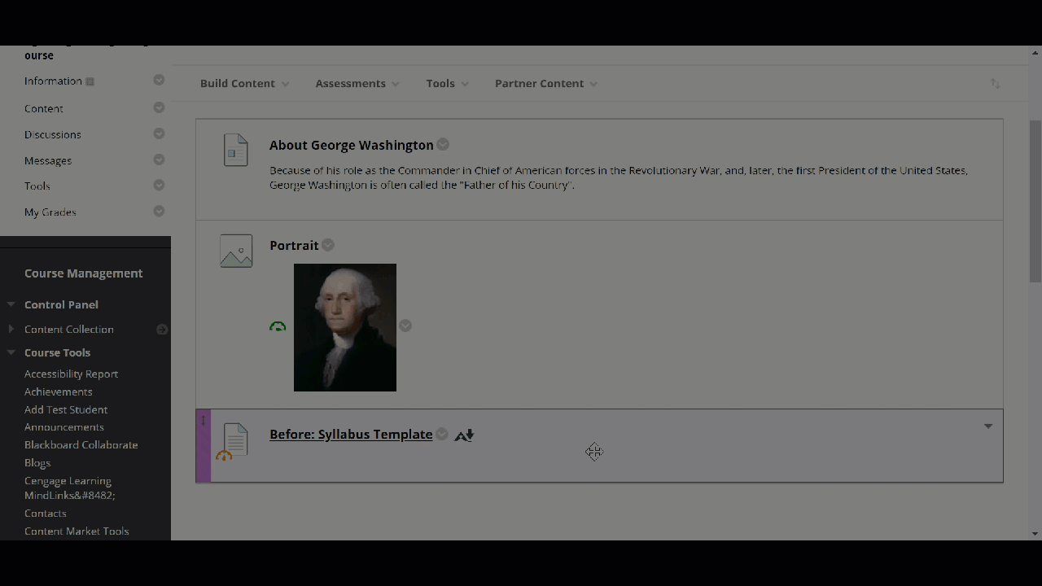
Example – Ally Upload

Slide 28
SECTION 5: Accessible Solutions
Color Contrast – MSFT Word
Images – MSFT Word
Tagging a PDF – Adobe Acrobat
Headings – MSFT Word
Images – Blackboard
Captioning – MSFT Stream
Notes:
Now that we understand the fundamental workflows for creating accessible documents, we are ready to move on to Section 5: Accessible Solutions.
This list might look intimidating, but it will be brief as the fundamental workflows will often overlap with the solutions.
Format of these of this section will be similar to the previous. We'll pause for the steps, and then see an example.
Hang in there. This is the last section before the conclusion.

Slide 29
a. Color Contrast – Microsoft Word 2016
Steps
In the Design tab, click the Page Color
Select a page color that provides high contrast
Additional Resources
Accessible Color Pallet Generator, Colorsafe.co
http://colorsafe.co/
"Contrast and Color Accessibility," WebAIM
https://webaim.org/articles/contrast/
Color Contrast Analyzer tool, The Paciello Group
https://developer.paciellogroup.com/resources/contrastanalyser/
Notes:
Color Contrast in Microsoft Word. A common issue identified in Ally in color contrast. We can address this by either changing the text color, or as described in this solution, change the background color of the page.
Some handy resources include an accessible color pallet generator to help you select compliant color combinations, and a link to download a color contrast analyzing tool.

Slide 30
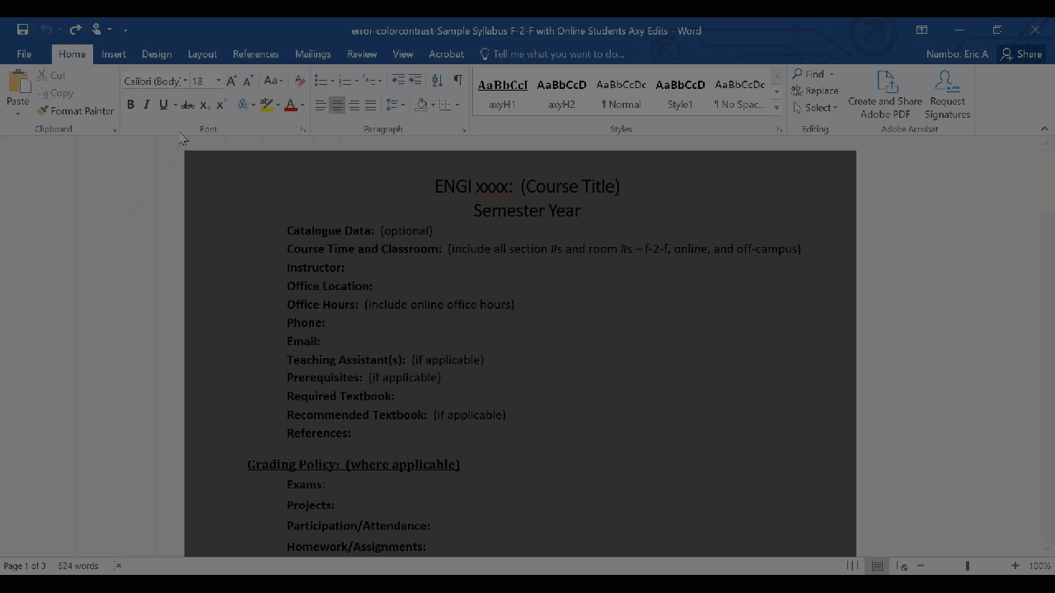
Example – Color Contrast

Slide 31
b. Images – Microsoft Word 2016
Steps
Right-click an image
Select Format Picture
Then select Layout & Properties
Select Alt Text
Type a brief description of the image
Additional Resources
"Fix Text Contrast," Blackboard
https://help.blackboard.com/Ally/Ally_for_LMS/Instructor/Improve_Accessibility/Fix_Text_Contrast
"How to Create an Accessible Word Document," Instruction@UH
https://www.instruction.uh.edu/knowledgebase/how-to-create-a-word-document-accessible/
Notes:
Color Contrast in Microsoft Word. A common issue identified in Ally in color contrast. We can address this by either changing the text color, or as described in this solution, change the background color of the page.
Some handy resources include an accessible color pallet generator to help you select compliant color combinations, and a link to download a color contrast analyzing tool.

Slide 32
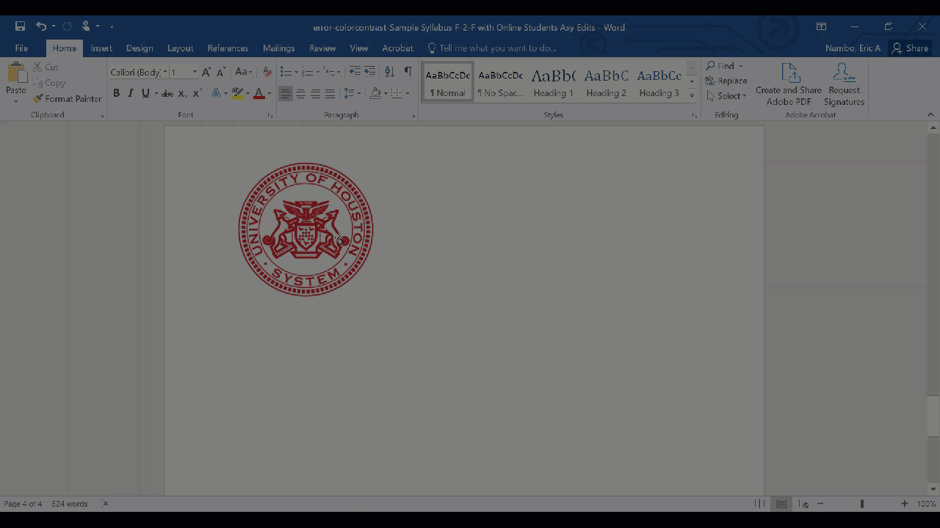
Example – Images

Slide 33
c. Tagging a PDF – Adobe Acrobat 2019
Steps
Run the Make Accessible Action Wizard
Progress through prompts until…
Autotag document
Resources
"Tag a PDF," Blackboard
https://help.blackboard.com/Ally/Ally_for_LMS/Instructor/Improve_Accessibility/Tag_a_PDF
"How to Fix PDF Accessibility Issues in Adobe Acrobat Pro DC 2019," Instruction@UH
http://www.instruction.uh.edu/knowledgebase/how-to-fix-pdf-accessibility-issues-in-adobe-acrobat-pro-dc-2019-windows-10/
Notes:
Tagging a PDF in Adobe Acrobat. Untagged PDFs lack the accessibility features that allow users with disabilities to scan content in the file. This solution shows how to autotag a PDF document to improve it’s score. Note: This solution is automatically applied with the Make Accessible Action Wizard. Refer to the aforementioned knowledgebase article for more info.

Slide 34
d. Headings – Microsoft Word 2016
Steps
In the View tab, click the Navigation Pane to see headings used in the document
Using the cursor, highlight text to be a heading
In the Home tab, select a Heading 1, 2, or 3 from the Styles menu
Additional Resources
"Add Headings to a Document," Blackboard
https://help.blackboard.com/Ally/Ally_for_LMS/Instructor/Improve_Accessibility/Add_Headings_To_A_Document
"Creating Accessible Microsoft Office Documents," Office of the Texas Governor
https://gov.texas.gov/organization/disabilities/accessibledocs2013-16
Notes:
Applying headings to word documents. Headings provide users the ability to scan documents, when done correctly. This solution calls for applying semantic styles to text in lieu of visually formatting text.

Slide 35
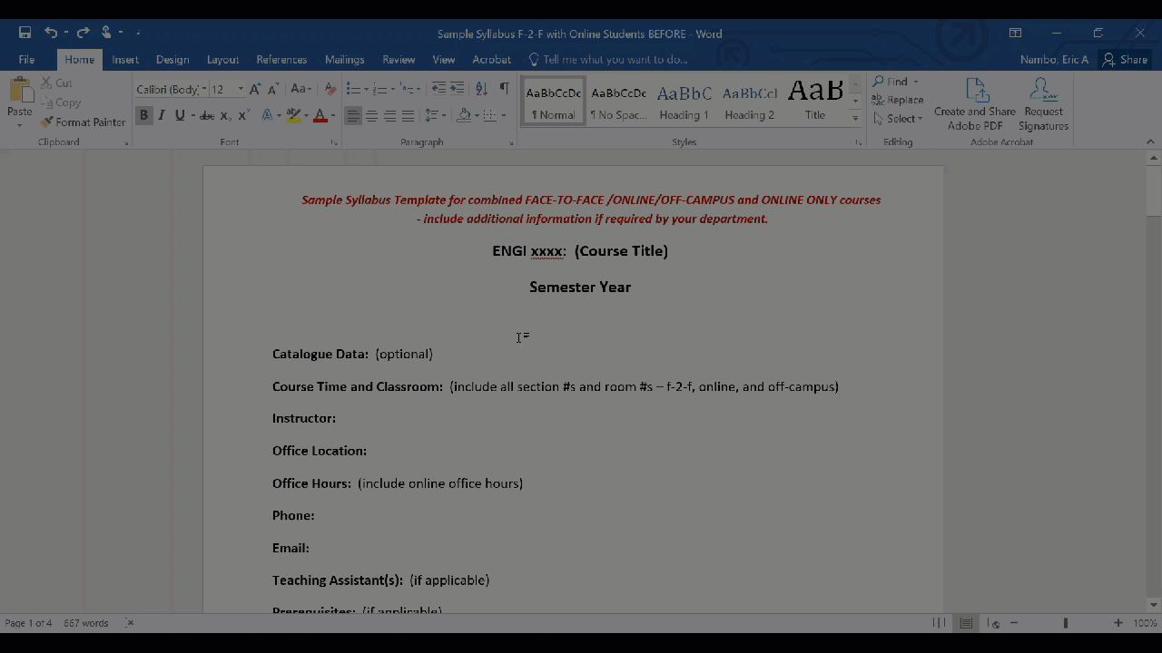
Example – Headings

Slide 36
e. Images – Blackboard
Steps
Click on the accessibility score
From the "Instructor Feedback" panel, enter alt text in the Add image description field
Click Add to save alt text
Additional Resources
"Add Image Descriptions," Blackboard
https://help.blackboard.com/Ally/Ally_for_LMS/Instructor/Improve_Accessibility/Add_Image_Descriptions
"Alternative Text," WebAIM
https://webaim.org/techniques/alttext/
Notes:
Applying alternative text to images in Blackboard. When uploading images to Blackboard, it’s imperative that we include alternative text or designate the image as decorative. This solution is straight forward as we can fix the issue in the Instructor Feedback Panel.

Slide 37
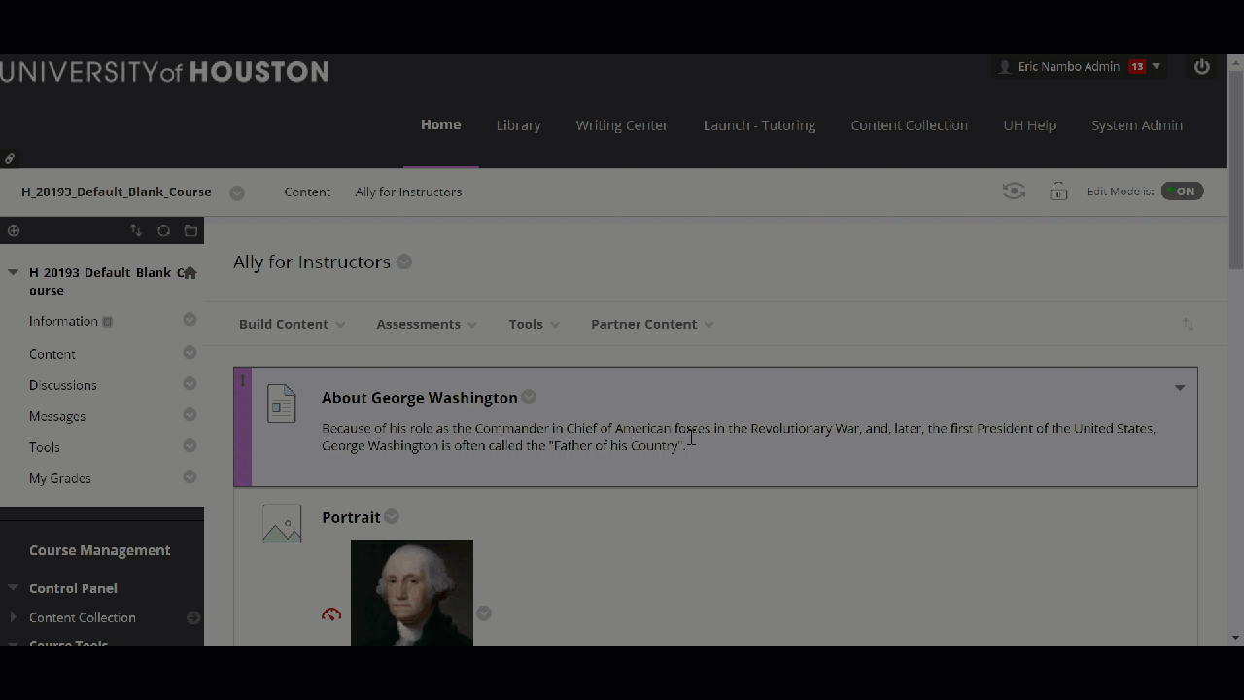
Example – Images in Blackboard

Slide 38
f. Captioning – MSFT Stream
Steps
Sign into your UH Office 365
Select Stream (If you do not see the Stream icon, click Explore all of your apps)
Click My content tab and select Videos from the drop-down menu
In the “Videos” tab, drag a video file there
In the “Options” tab, select Autogenerate a caption file
Select Publish now. Microsoft Stream will automatically begin generating captions. Note: The time to generate the automatic caption depends on the length of your video
If you need to edit the automatic captions, click Edit in the “Transcripts” window.
When you are in Edit mode, you can select one segment at a time.
Resources
"How to Generate Automatic Captions in Microsoft Stream Video," Instruction@UH
http://www.instruction.uh.edu/knowledgebase/how-to-generate-automatic-captions-in-microsoft-stream-video/
"How to Edit Captions on Microsoft Stream Video," Instruction@UH
http://www.instruction.uh.edu/knowledgebase/how-to-edit-captions-on-microsoft-stream-video/
Notes:
Generating Autocaptions using Microsoft Stream. If you have prerecorded video content, it’s essential that they be captioned. Fortunately, instruction@UH has created an instructional knowledge base article on how to automatically generate captions using Microsoft stream. Note: Autocaptions are not perfect. Autocaptions should be reviewed and edited for accuracy.

Slide 39
Conclusion
Summary
Additional Support

Slide 40
a. Summary
Learning Objectives
Summarize the features
Identify the user interface components of Ally
Understand the types of feedback generated
Review fundamental workflows for producing accessible content
Explore solutions to common accessibility issues
Ally is user friendly accessibility tool for faculty
Practice the fundamental workflows
Recall accessibility solutions
Keep this presentation for reference

Slide 41
b. Additional Support
UH EIR Accessibility Website - Resources
https://www.uh.edu/equal-opportunity/eir-accessibility/eira-resources
UH Faculty and Departmental Instructional Support (FDIS)
https://www.uh.edu/fdis/
Instruction@UH – Accessibility
https://www.instruction.uh.edu/accessibility/
Blackboard Ally for LMS for Instructors
https://help.blackboard.com/Ally/Ally_for_LMS/Instructor
Eric Nambo, EIR Accessibility Coordinator
Phone: 713.743.5968
Email(s): accessibility@uh.edu | eanambo@uh.edu

