Slide 1
Concur Training
Olivia Guo --- AP Travel
October 2023

Slide 2
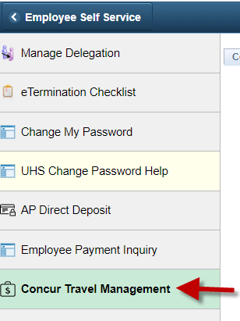
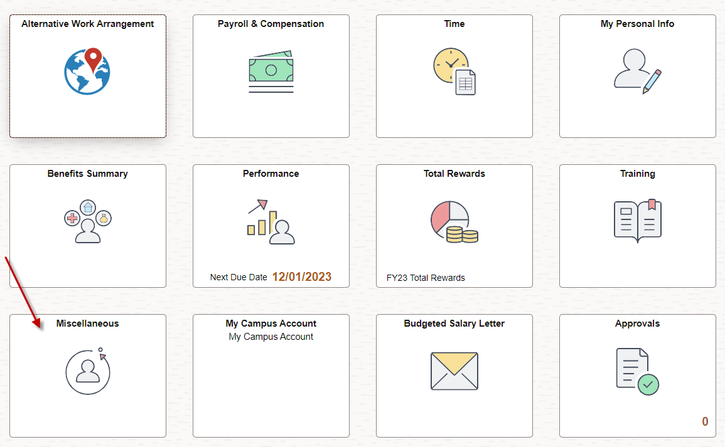
Getting Started
→For UH employee, go to P.A.S.S., click on “Miscellaneous”, followed by “Concur Travel Management”

Slide 3
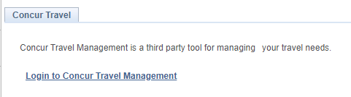
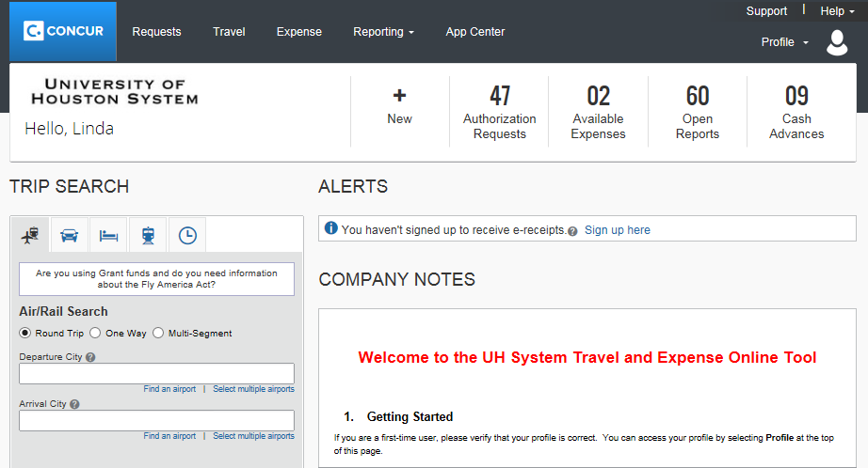
  → If you are already set up as a Concur user, you will see the hyperlink “Login to Concur Travel Management”. Click on the hyperlink.
  → You will see the Concur main page.

Slide 4
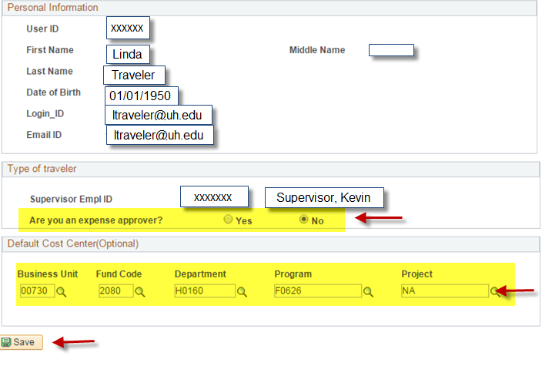
→ If you are not set up as a Concur user, you will see the self-service page. Complete the information highlighted below and click on, “Save”

Slide 5
Concur Travel Request
All UH travel for employees, prospective employees, students, prospective students, university guests, contractors, and regents
Completed and approved before travel
Estimate of expenses
Authorization to travel
Reimbursement
Travel Request must be created in the profile of the person who will be traveling, not delegate or travel card custodian

Slide 6
Concur Travel Request
Created in Concur by traveler or delegate
Workflow approval
  Employee travelers must submit their own TR into workflow to acknowledge their review
Approvers are automatically notified when a Travel Request is pending their approval
An approved Travel Request is required for all university travel, whether paid by UH or not
Don’t book travel until the TR is fully approved

Slide 7
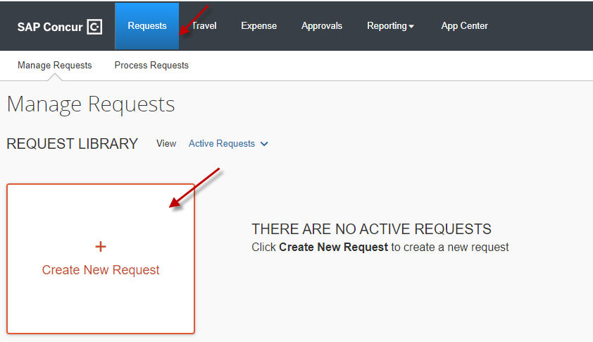
Creating a new Travel Request
Step 1: Creating a new Travel Request
On the main menu, click Requests → + Create New Request

Slide 8
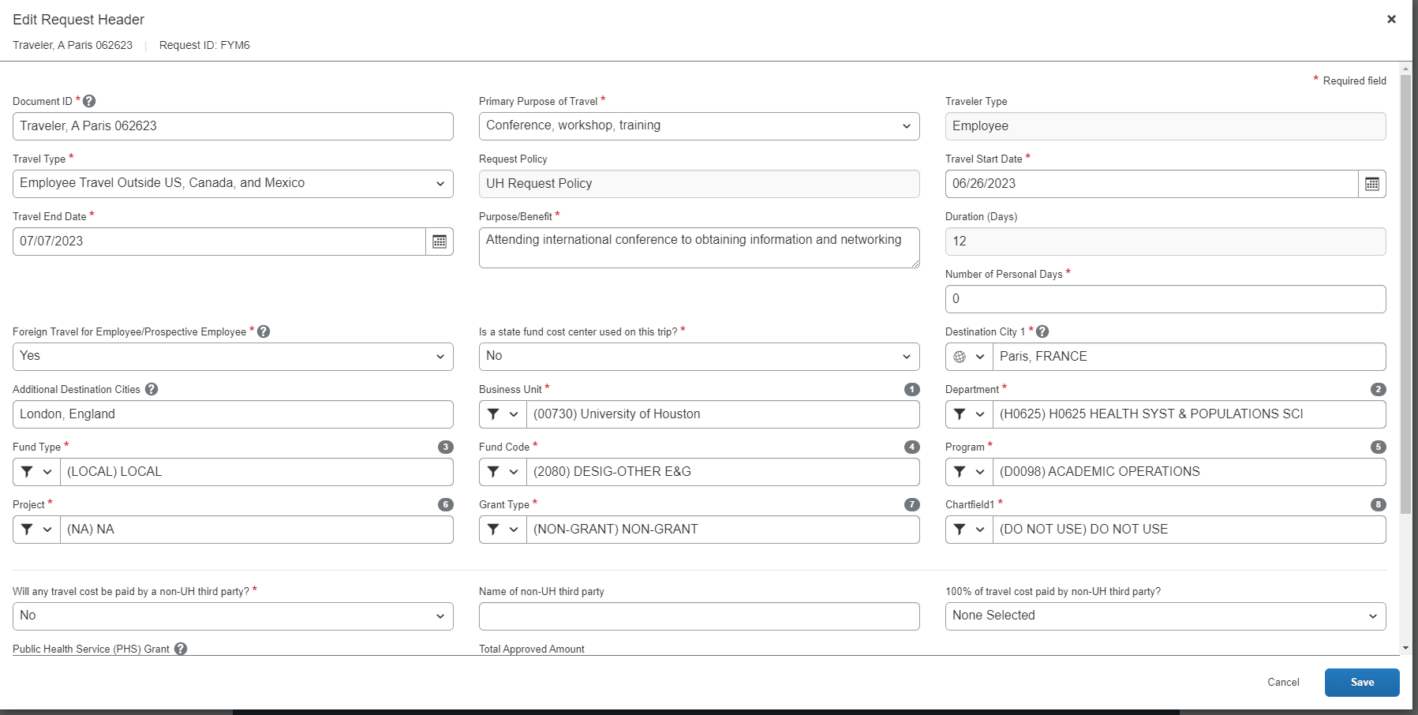
Creating a new Travel Request
Step 2: Complete the information in the Request Header

Slide 9
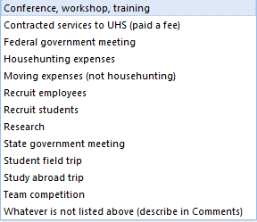
Creating a new Travel Request
Step 2: Complete the information in the Request Header
Document ID
Enter the travel information in the following format:
Traveler Last name, Traveler First Name initial, Destination City, Departure Date (MMDDYY)
Note: You can enter up to 30 characters in this field.
Primary Purpose of Travel
Select the primary purpose of the travel from the dropdown box. The dropdown box lists the following purposes:

Slide 10
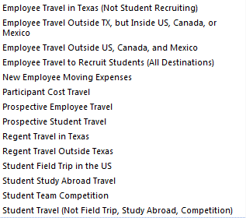

Creating a new Travel Request
Step 2: Complete the information in the Request Header
Traveler Type
This field is grayed out. Concur will automatically pull this information from the user profile.
Travel Type
Select the travel type from the dropdown box:

Slide 11
Creating a new Travel Request
Step 2: Complete the information in the Request Header
Request Policy
This field is grayed out. It indicates that Travel Request is processed in compliance with the UH Request Policy.
Travel State Date and Travel End Date
Enter the departure date and return dates.
Purpose/Benefit
Enter the purpose/benefit of the trip.
Duration (Days)
You do not need to enter any value in this field. Once the request is saved, Concur computes the travel days and indicate it in this field.
Number of Personal Days
Enter the number of personal days planned for the trip. If none, enter “0” (zero).

Slide 12
Creating a new Travel Request
Step 2: Complete the information in the Request Header
Foreign Travel for Employee/Prospective Employee
Indicate whether the travel is to or from countries outside Canada, Mexico, the United States, and the U.S. territories and possessions for an employee or prospective employee.
Is a state fund cost center used on this trip?
Indicate whether state funds will be used for the trip.
Destination City 1 and Additional Destination Cities
Enter the destination city or cities. Multiple destinations can be indicated in the “Additional Destination Cities” using semi-colons (e.g., Paris; London, etc.)
Business Unit, Department, Fund Type, Fund Code, Program, Project, Grant Type, Chartfield1
Concur automatically pulls these fields from the traveler’s profile, if a default cost center is entered in the profile. To change or enter a cost center, select each field in the order presented (Business Unit, Department, Fund Type, etc.)

Slide 13
Creating a new Travel Request
Step 2: Complete the information in the Request Header
Will any travel cost be paid by a non-UH third party?
Enter “Yes” or “No”.
Name of non-UH third party
If “Yes” is selected for a non-UH third party payment, enter the name of the third party.
100% of travel cost paid by non-UH third party?
If “Yes” is selected for a non-UH third party payment, indicate whether 100% is paid by the third party. If 100% is paid by the third party, you do not need to provide additional information. If less than 100% is paid by the third party, you MUST attach a letter from the third party indicating the information about their payment.
Public Health Service (PHS) Grant
If “Yes” is selected for a non-UH third party payment, indicate the traveler’s association with a PHS grant. If the traveler’s salary was paid from a PHS grant and/or he/she is an investigator on the grant, Concur sends an e-mail notification to the Office of Research Policies, Compliance, and Committees, so ORPCC can follow up with the department later. ORPCC does not approve the Travel Request or delay the approval process.

Slide 14
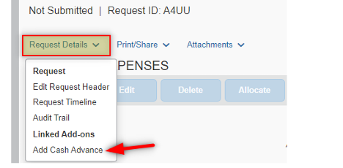
Creating a new Travel Request
Step 3: If you are requesting a Travel Advance, complete the Cash Advance section.
Note: Travel Advances are available for employee foreign travel and group travel only. Only employees who are eligible for Travel Advances may receive Travel Advances. The Cash Advance section is on the bottom of the Request Header page. Enter the amount.

Slide 15
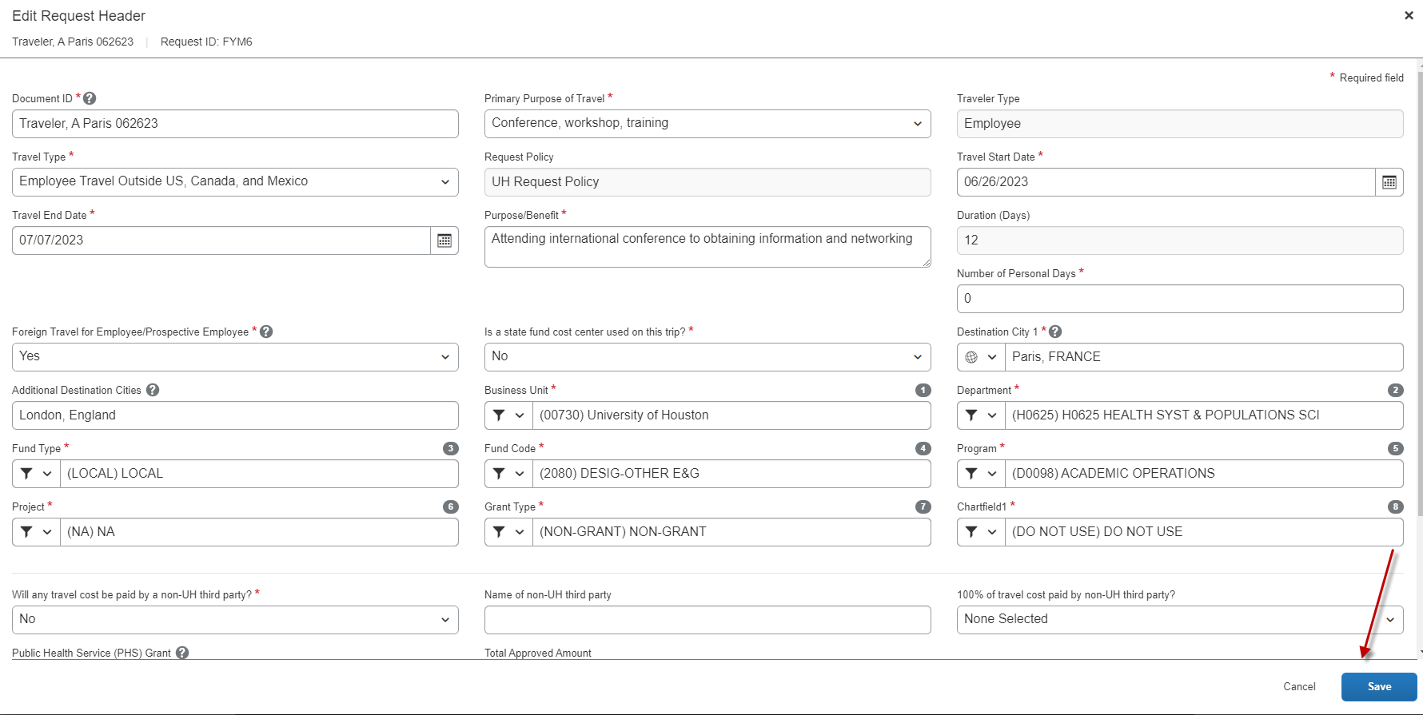
Creating a new Travel Request
Step 4: Save the header information by clicking on “Save”

Slide 16
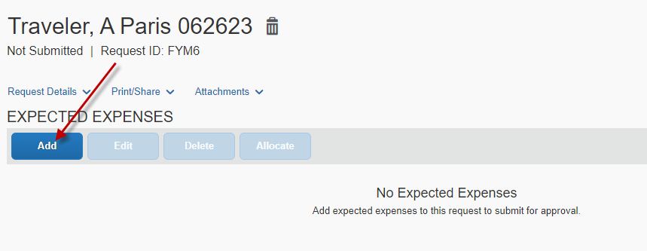
Creating a new Travel Request
Step 5: Complete the information in the Expected Expenses page by Adding the expected expenses for your trip

Slide 17
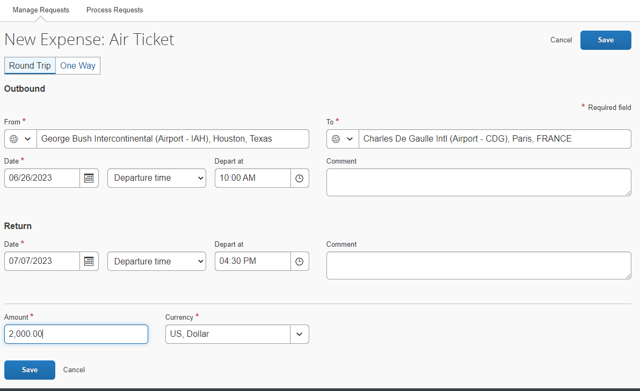
Creating a new Travel Request
Step 5: Complete the information in the Expected Expenses page
Click on an appropriate icon to complete the segment information
Airfare (example)
Enter the request amount, departure/arrival cities, and dates. Other fields are optional. Click on “Save”

Slide 18
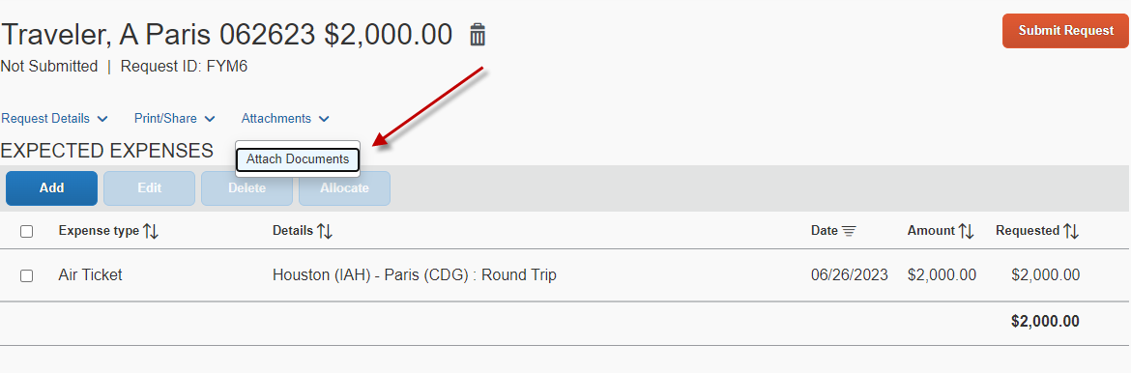
Creating a new Travel Request
Step 6: Attach required documents if necessary.
Click on “Attachments” and select “Attach Documents”

Slide 19
Creating a new Travel Request
Step 6: Attach required documents if necessary.
Examples of documents to attach to the Travel Request:
Conference program/announcement or Business itinerary/agenda
Export Controls and Travel Embargo Form MUST be attached for foreign travel
Fly America Act Waiver Checklist
Office of State-Federal Relations confirmation for travel to D.C. on state funds

Slide 20
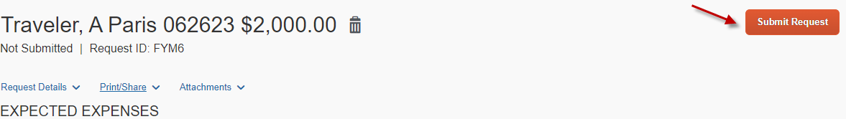
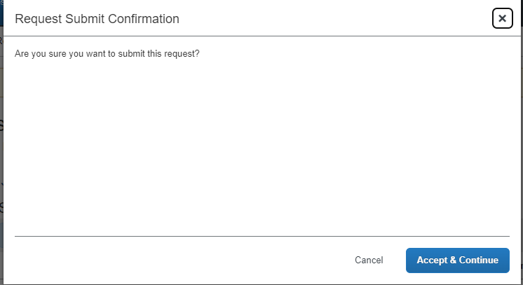
Creating a new Travel Request
Step 7: Submit the request in workflow
Click on “Submit Request”
The system then asks for your confirmation. Click on “Accept & Continue”

Slide 21
Travel Advances
Used to receive money before travel
Criteria:
  1. Local Cost Centers Only
  2. Employee Foreign Travel or Group Travel
Requirements
  1. Employee Foreign Travel: VP approval, Export Controls, Agenda, and Breakdown of expenses
  2. Group Travel: Roster, Agenda, Breakdown of expenses

Slide 22
Foreign Travel
Travel Request
VP Approval (Concur automatically routes TR through VP)
Export Controls and Travel Embargo Form
Agenda
Fly America Act Waiver Checklist (if applicable)
  Foreign air carrier
  Fund: 5013, 5014, 5015, 5033, 5034 and 5035.
Documents available in Concur (Travel tab)
Link: http://www.uh.edu/research/sponsored-projects/proc-pol-guide/travel/
Notes:
Left off here

Slide 23
Key Points to Remember
Only economy/coach class airfare is reimbursable
The university allows add-ons to economy/coach airfare such as extra legroom, early check-in, seat selection and traveler’s additional luggage fee
Meals are always reimbursed based on actuals (not Per Diem)
Itemized receipts must be provided if over Per Diem Rate
  Receipts not required for incidentals less than or equal to $75
  Expense Report must be created in the profile of the person who traveled; for reimbursements

Slide 24
Key Points to Remember
Airfare
Must be purchased at the lowest price available (only economy/coach class is allowed).
Extra legroom, early check-in, seat selection and the traveler’s additional luggage is allowed without justification statement.
Additional baggage fees incurred due to unauthorized Travelers are Not Allowed.
Rental Car
Luxury vehicles and additional cost upgrades without appropriate business reason are Not Allowed.
SUVs, Vans and larger sized vehicles may be permissible if three or more Travelers will be traveling in one vehicle.
Hotel
Must adhere to the daily Meal & Lodging Limits.
Additional fees for unauthorized Travelers are Not Allowed (i.e., rollaway bed).
Room upgrade is not allowed.

Slide 25
State Contracted Rental Car Vendor Information
Enterprise (Business Use Only)
Hertz (Business Use Only)
Please contact AP Travel for contract code

Slide 26
Travel Reimbursement
Expense Report
Required for reimbursement for travel expenses
Only economy/coach class airfare
Meals are always reimbursed based on actuals (not Per Diem)
Itemized receipts must be provided if over GSA Rate
  Receipts not required for incidentals less than or equal to $75
  Expense Report must be created in the profile of the person who traveled; for reimbursements
  Department should not create PCC1 voucher in PeopleSoft to request reimbursement.

Slide 27
How to assign a Delegate in Concur
You may check to see who is listed as your delegate and who you are listed as delegate, by following the steps mentioned below:
Login to Concur, then click on Profile → Profile Settings → Assistants and Travel Arrangers Here you can view who can assist or book travel for you.

Slide 28
Deadline for Submittal of Reimbursement Expense Reports
Traveler has up to 60 days after completion of travel to turn in receipts to the dept.
  If turned in after 60 days, must get routed to the Tax Department (with Taxable Payments or Reimbursements to Employees form-Exhibit B, SAM 03.D.06) before submitting to AP
Dept has a maximum of 15 days after received from traveler to submit to AP
  If submitted after 15 days, justification is needed
Notes:
If last travel day fall on a Friday, days are counted beginning Saturday.

Slide 29
Deadline for Submittal of
Travel Card Expense Reports
Cardholders and custodians are responsible for submitting Expense Reports in Concur through the certifying signatory to Accounts Payable no later than the 25th of the month following the month in which those transactions occurred.
For example, Travel Card charges with a transaction date in September (September 1 – September 30) must be submitted to Accounts Payable on an Expense Report by October 25 in Concur. If the 25th falls on a weekend or holiday, the due date will be the following business day unless otherwise announced by AP.

Slide 30
Travel Advances
A Concur Expense Report must be created and submitted to properly process the Travel Advance.
The appropriate Travel Request must be linked to the Expense Report.
If the expenses were less than the amount issued, the Traveler will need to pay back the University of Houston for the excess amount.
In Concur, the returned amount must be coded as, “Cash Advance Return.”
If the expenses were greater than the amount issued, the travel expenses must be entered in the Concur Expense Report. Concur will automatically subtract the travel advance amount from the travel expense amounts entered in the expense report. Concur will then generate a voucher to issue a reimbursement for the excess amount.

Slide 31
Moving & House hunting Expenses
Not allowed on a travel card or state fund
Required documents:
Travel Request
Note: Create a Travel Request for House hunting expenses and another one for the actual Relocation expenses.
Addendum A
Offer Letter
Exhibit B
Itemized receipts (including meals while moving)
Link: http://www.uh.edu/administration-finance/tax-information/moving-and-relocation/

Slide 32
Creating a Reimbursement Expense Report
On the Concur main page, click Authorization Requests in the header or in My Tasks section then, look for the Travel Request for which you will be creating an Expense Report
Select the appropriate Travel Request and click on the Create Expense Report tab
The system will take you to the Expense Report Header. Select an answer for the following questions and click on Next
Traveler is Both a non-employee and a foreign national
All receipts submitted within 60 days after trip or moving expense
Is this for Department Travel Card charges? (If yes, complete the 4 digits and Request ID number)
Note: The information for the remaining fields is automatically copied from the corresponding Travel Request.
On the bottom of expense report header, you will see “Travel Allowances” section. This section only applies to state fund travel. For local fund travel, select “No, I do not require Travel Allowance” and then “Save”
Once inside of the travel request, select the “Create Expense Report” tab.
Select “Create New Expense” tab to view a panel list of expense types. Click on
the applicable expense type and enter the required information for each expense.

Slide 33
Creating a Reimbursement Expense Report
--- continued
Attach a receipt, if required. Concur will tell you if a receipt is required for each Expense Type.
Go to Receipts and select Attach Receipt Images
Select an applicable expense. Then click on Browse
Select a file and click on Upload
Note: If you want to upload documents at the Expense Report Header Level (not for individual expenses), then do not select an expense. Just click on Receipts → Attach Receipt Images
Examples of documents you would upload to the Expense Report Header Level include:
Post-trip report
Fly America Act Waiver Checklist
Job Offer Letter
Addendum A (Authorization for Moving and Relocation Expenses)
Exhibit B (Taxable Payments or Reimbursements to Employees)
Click on Submit Report to submit the Expense Report into Workflow

Slide 34
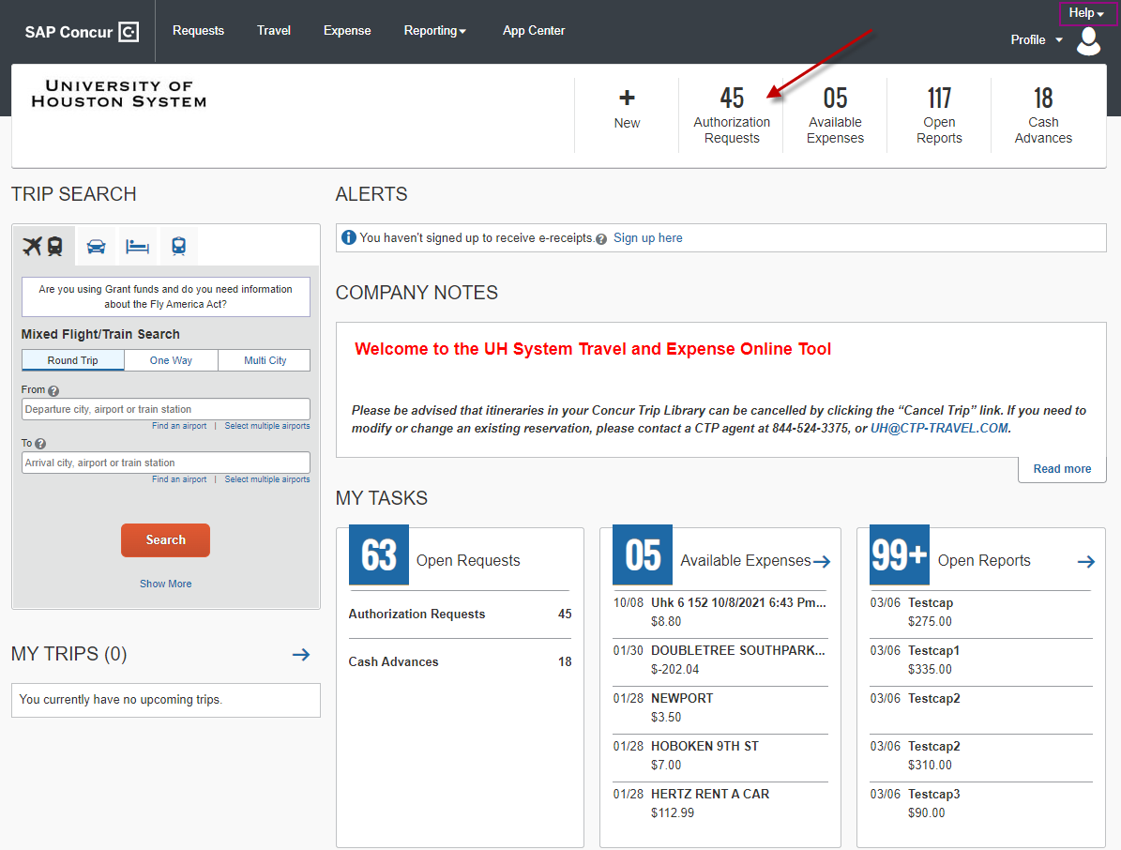
Creating a Reimbursement Expense Report
On the Concur main page, click Authorization Requests then, look for the Travel Request for which you will be creating an Expense Report

Slide 35
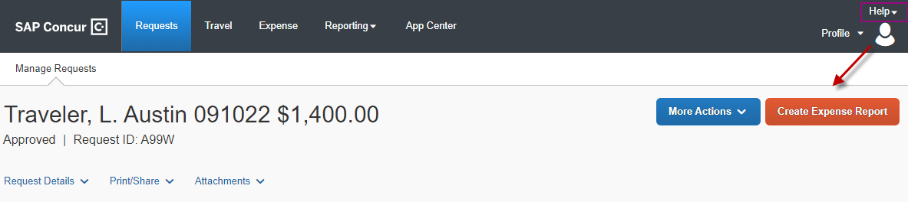
Creating a Reimbursement Expense Report
Once inside of the travel request, select the “Create Expense Report” tab.
The system will take you to the expense report header. Select an answer for the following questions and click on Next.
Traveler is BOTH a non-employee and a foreign national
All receipts submitted within 60 days after trip or not moving expense
Is this for Department Travel Card charges? (If yes, complete the 4 digits and Request ID number)

Slide 36
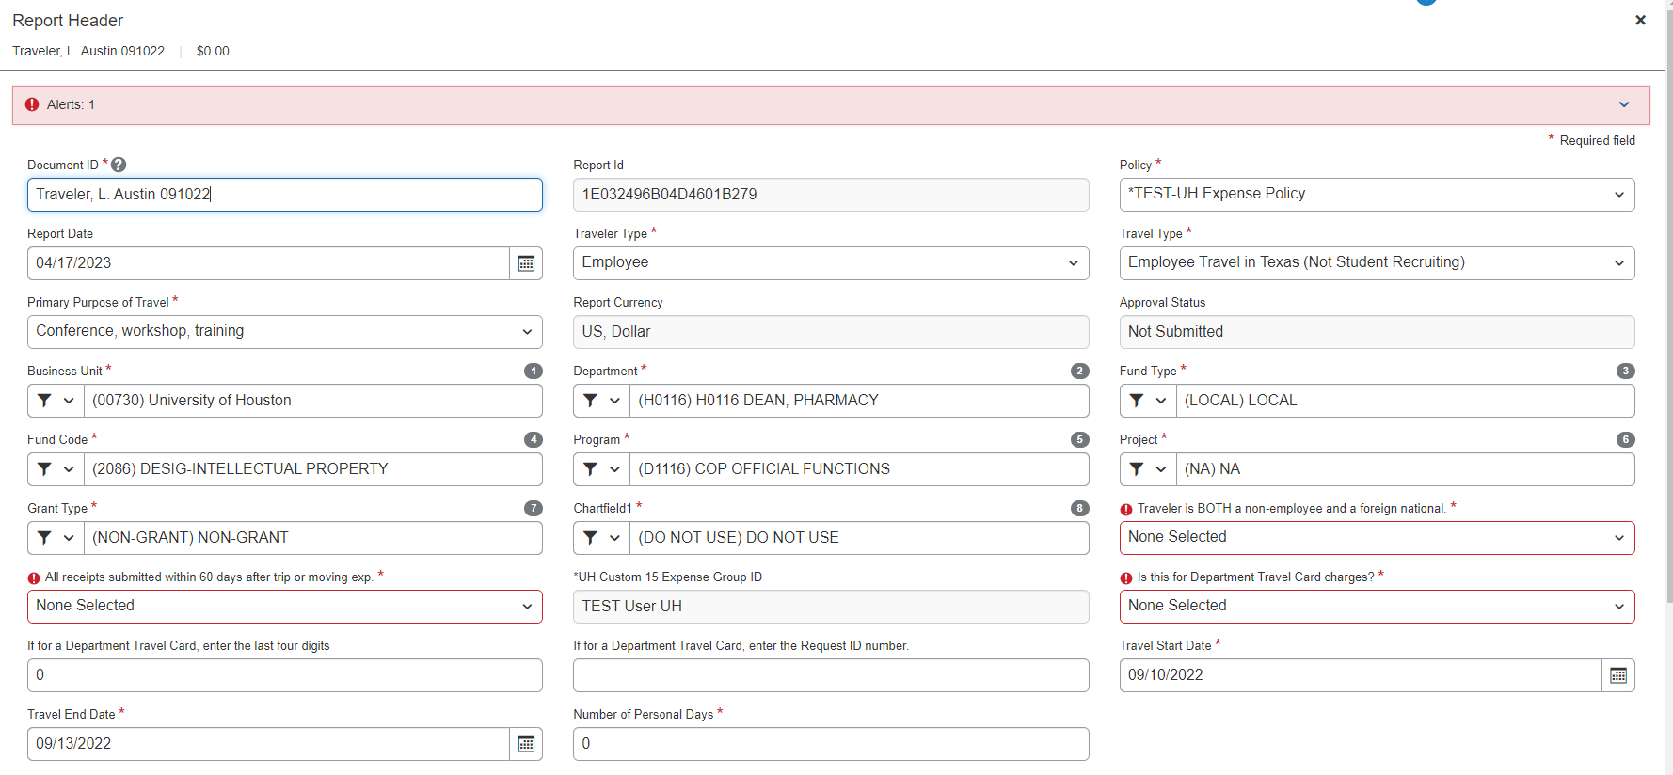
Creating a Reimbursement Expense Report
The information for the remaining fields is automatically copied from the corresponding Travel Request.

Slide 37
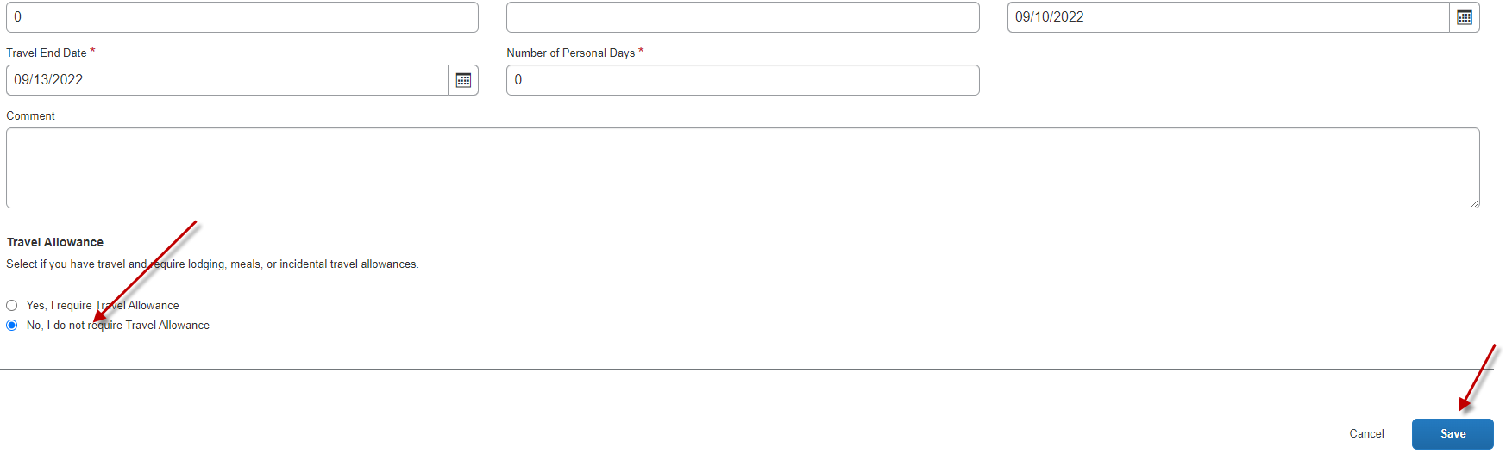
Creating a Reimbursement Expense Report
On the bottom of the header, you will see “Travel Allowances” section. This section only applies to state fund travel. For local fund travel, select “No, I do not require Travel Allowance”.
After that, click Save.

Slide 38
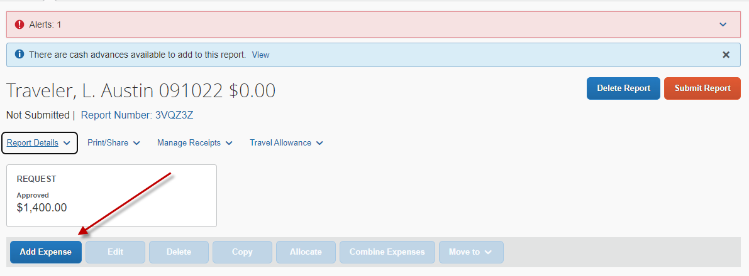
Creating a Reimbursement Expense Report
Expenses can now be recorded by selecting “Add Expense”.
Select “Create New Expense” tab to view a panel list of expense types. Click on
the applicable expense type and enter the required information for each expense

Slide 39
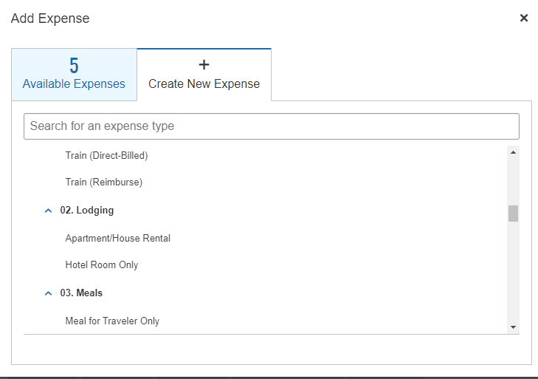
Creating a Reimbursement Expense Report
Example – Lodging
Click on Hotel Room Only
Complete the required fields, and click on the “Itemizations” tab.
Note: If room rate and tax is not separated (foreign travel), place a checkmark for “Combine room rate and taxes into a single entry).

Slide 40
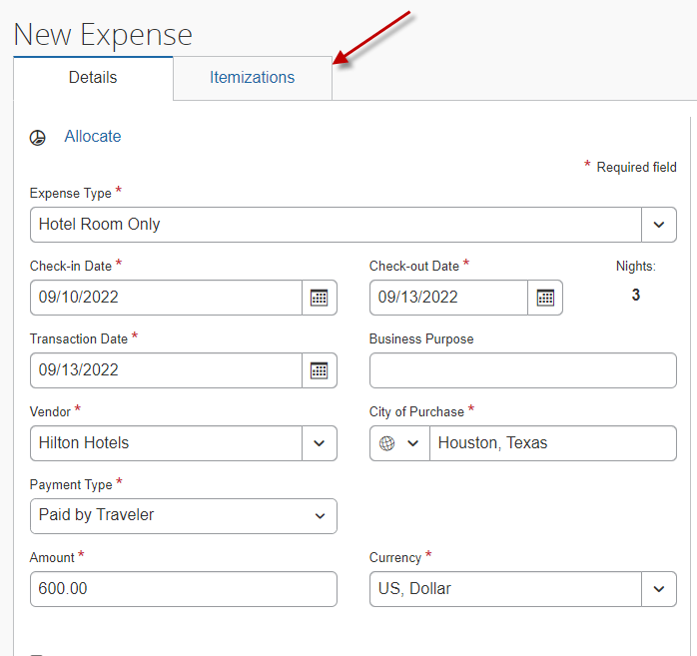
Creating a Reimbursement Expense Report
Select Hotel Room Only, complete the required fields, and click on “Itemizations” tab
Note: Be sure to select the correct City of Purchase and the Transaction Date so that the Concur system can load the appropriate currency exchange rate.

Slide 41
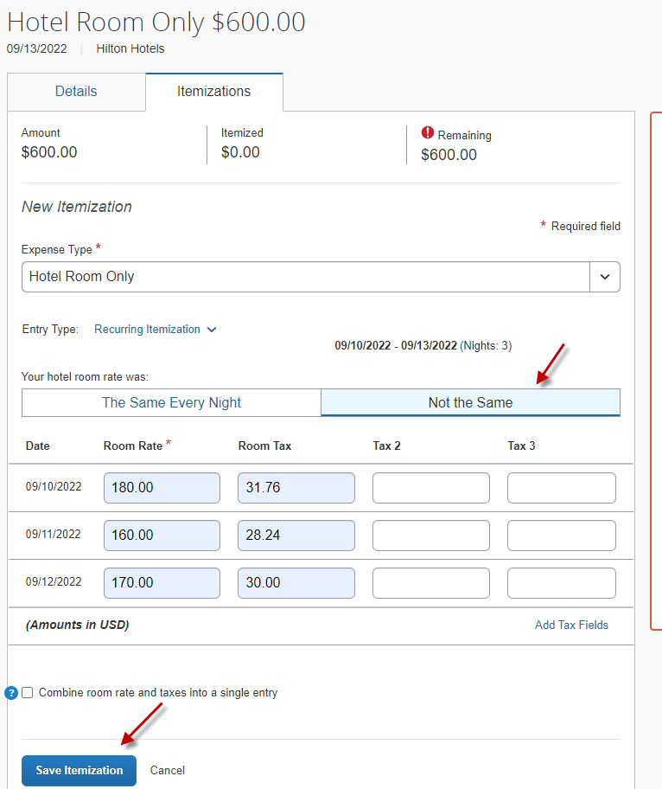
Creating a Reimbursement Expense Report
Based on the hotel rate per each night, select either “The Same Every Nights” or “Not the Same”. For example, “Not the Same” is used, enter the room rate and room tax to reflect the amounts on the hotel folio. Click on “Save Itemization”.

Slide 42
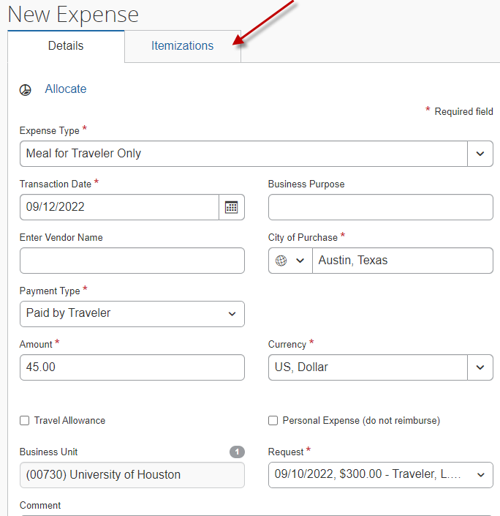
Creating a Reimbursement Expense Report
Example – Travel Meals (Itemization required for alcohol)
Select Meals for Traveler Only, complete the required fields, and click on the “Itemizations” tab ( only if itemizing alcohol, otherwise save or add another expense).

Slide 43
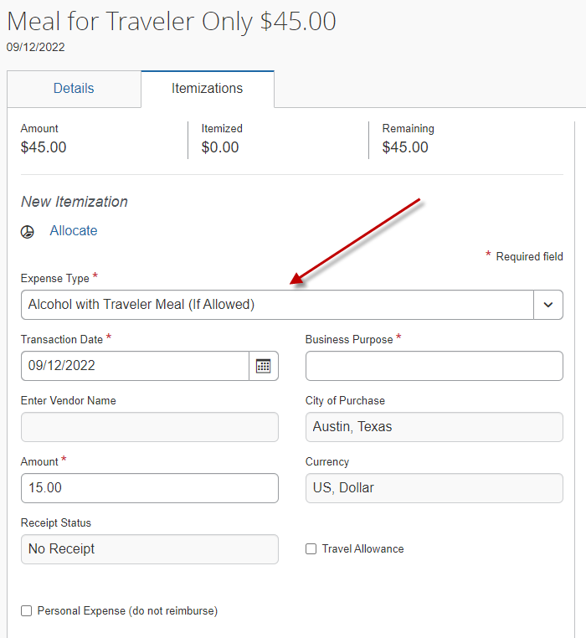
Creating a Reimbursement Expense Report
Example – Travel Meals (Itemization required for alcohol) --- Continue
To itemizing alcohol, select “Alcohol with Traveler Meal (If Allowed)”, enter the required information, and then save

Slide 44
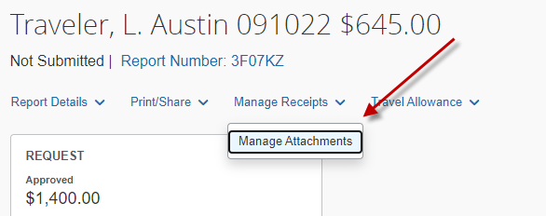
Creating a Reimbursement Expense Report
Attach a receipt, if required. Concur will tell you if a receipt is required for each expense type.
To attach receipts at the report level, select “Manage Receipts”, followed by “Manage Attachments”.
Documents can be attached by selecting “Upload Report Level Attachment” if the expense report does not contain any receipts.

Slide 45
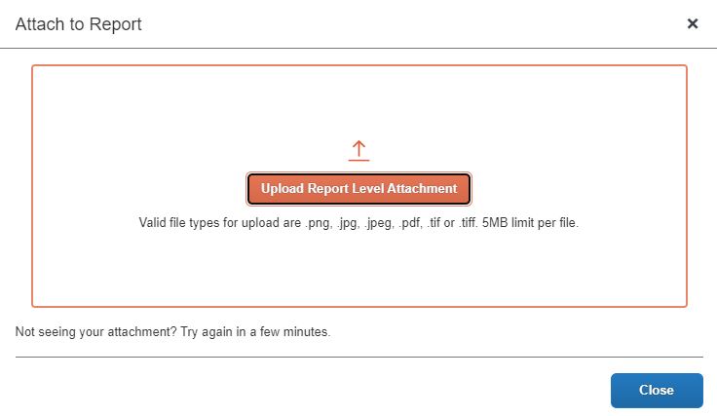
Creating a Reimbursement Expense Report
You can keep adding documents at report level.
Examples of documents you would upload to the expense report header level:
Post-trip travel report ( for foreign travel only)
Conference itinerary / daily agenda ( if not attached with Travel Request )
Fly America Act Waiver Checklist if it is necessary to use non-US carrier for international travel on state funds
Moving Expense Worksheet
Taxable payments or reimbursements to employees form, if applicable
After all documents are uploaded, click “Submit Report”

Slide 46
Creating an Expense Report for a Department Travel Card
Key Points:
https://uh.edu/finance/Forms/Concur_Travel_Access_Form_Non_Employee.pdf
Create an Expense Report for Department Travel Card
An Expense Report must be created for each trip made by a traveler.
Department Travel Card custodians create an Expense Report for each trip charged to their Department Travel Card. (This is different than creating an Expense Report for a traveler’s out-of-pocket expenses and/or Individual Travel Card expenses as the traveler’s delegate.)
In your Concur main page, click on Available Expenses in the header. This section lists your UH Travel Cards and their outstanding amounts, which have not been assigned to an Expense Report. Review the information.
Concur will take you to the Manage Expenses page. Scroll down to the bottom of the page. Below the card list, you will see a list of charges place on your Department Travel Card(s).
Place a checkmark for the charge(s) that belong to the same trip. Then click on Move. Select an appropriate Expense Report for the charge(s). Click on Import to bring those charge(s) to the Expense Report.

Slide 47
Creating an Expense Report for a Department Travel Card
If you selected New Expense Report, the system will take you to the Expense Report Header page. Complete the Report Header information. (See the training material “Creating an Expense Report” for details.)
For Department Travel Cards Only:
On the Expense Report Header, select “N/A – Department Travel Card Report” when asked if receipts were submitted within 60 days.
Enter the last 4 digits of the Department Travel Card number.
Enter the traveler’s Travel Request ID.
Click on Next
You do not need to complete the Travel Allowances for Report page for local funds.
The system will bring in the selected Department Travel Card charge(s) to the Expense Report automatically. Complete the Expense Report.

Slide 48
Creating an Expense Report for a Department Travel Card--- continued
Click on the Expense and complete the required information fields for the expense. Then click Save
Upload the backup documents (see the training material “Creating an Expense Report” for details).
Submit the Expense Report into Workflow by clicking on Submit Report

Slide 49
Frequently made mistakes
Incorrect travel type/traveler type on expense report, not same as in travel request
Not linking travel request with expense report
Not providing the travel request ( department travel card expense report )
Incorrect expense report ID format
Conference agenda or daily itinerary is not attached

Slide 50
Travel Card Requirements
  Complete the travel card application through DocuSign
  Complete HR form and attach with application: Authorization for Criminal History Investigation (CHRI Request Form valid for up to 6 months) *Procurement/Travel Card Clearance
  http://www.uh.edu/human-resources/talent-acquisition/chri-request/
  Complete the T Card Cardholder training (SF2304) through T.A.P. (Valid for up to 1 year) and attach with DocuSign
  Login to P.A.S.S. → Training → Request Training → Search by Course Number → SF2304 → View Available Sessions → Select Session (0001) → Continue
  http://www.uh.edu/adminservices/PASS/trainingenrollment.htm

Slide 51
Travel Card Overview
Primary Custodian
Employee who has custody of the travel card
Responsible for submitting expense reports in Concur
Expense Report must be created in the profile of the primary custodian (cardholder); to close out travel card charges
Delegates in Concur
Employees authorized to create/review Travel Request and/or Expense Reports for specific employees and/or non-employees.
Submit Travel Requests and/or Expense Reports in Concur on behalf of specific non-employees (employees must submit their own Requests/Reports).
Approve Travel Requests and/or Expense Reports in Concur on behalf of specific employee approvers.

Slide 52
Additional Information
Concur and Tcard Training Material
Visit: https://uh.edu/office-of-finance/ap-travel/concur-tcard/tm-printable/
University of Houston Travel Policies
Visit: https://uh.edu/office-of-finance/ap-travel/general/travel-policies/
Insurance
Visit: https://uh.edu/office-of-finance/ap-travel/general/insurance/
Travel Forms
Visit: https://uh.edu/office-of-finance/ap-travel/forms/

Slide 53
AP Travel Contacts
Olivia Guo– AP Manager
713-743-6920
lguo9@central.uh.edu
Naomi Compton– AP Analyst II
713-743-3671
nrcompto@central.uh.edu
Tripti Das --- AP Analyst II
713-743-2542
tdas2@central.UH.EDU
Monica Li --- AP Analyst II
713-743-8496
smli3@Central.UH.EDU
Ace Anzaldua --- AP Analyst II
713-743-0365
crguyanz@Central.UH.EDU
AP Travel Team
aptravel@uh.edu
aptravel@entral.uh.edu
Tax Dept.
Tax Office
tax@uh.edu
Concur System
Concur Support
Frank Pham – Coordinator, Application Security, Financial Computing Systems
713-743-5112
concur@central.uh.edu

